Slide 1


Citizens, Equality, Rights and Values
Info session for the applicants
CERV-2025-DAPHNE
Call for proposals to prevent and combat
gender-based violence and violence against children
JUST D3 - Gender Equality
JUST C2 - Fundamental Rights Policy
JUST H3 - Budget, Programmes and Financial Management
20 March 2025

Slide 2

Agenda
9:00 - 9:20 | Welcome & Overview on CERV | Michela Castellucci – JUST H3
9:20 - 10:10 | Information on policy priorities, areas of intervention, budget available, expected activities and results + Q&A | Policy officers - JUST D3 Gender equality & C2 Fundamental rights policy
10:10 - 11:00 | Eligibility conditions, evaluation, proposal structure, key figures from previous years, horizontal aspects + Q&A | Michela Castellucci – JUST H3
11:00 - 11:10 | Registration & validation process (F&T Portal) | REA Central Validation Service
11:10 – 11:20 | Short coffee break
11:20 - 12:00 | Specific budgetary aspects related to the lump sums type 2 + Q&A | Grant management officers, JUST H.3
12:00 - 12:10 | National Contact Point (NCPs) & their role in assisting the applicants | Lucy Alaphilippe – NCP France
12:10 -12:15 | Closing remarks | Michela Castellucci – JUST H3

Slide 3


Housekeeping
Microphone
Camera
OFF
OFF
Stay muted when not speaking
Please keep your camera off when not speaking

Slide 4

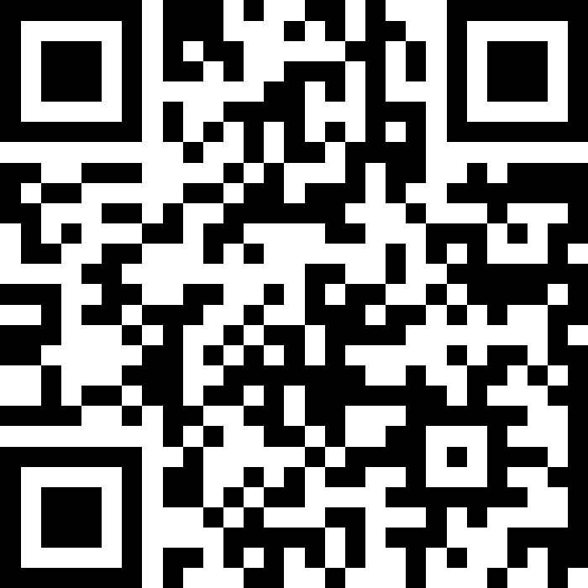
Where are you joining us from?
# 2782412
🔑 pwuxvx

Slide 5
Eligible countries for CERV
All 27 EU Member States
+ their overseas countries and territories
+ list of non-EU countries* that have signed an association agreement with CERV OR will have signed it before the Grant Preparation, if awarded
Check regularly the advancement of the negociations to join CERV

Slide 6








*Non-EU countries –
Advancement of negotiations
Serbia
Kosovo
Bosnia and Herzegovina
Participate
in the CERV programme
Albania
Ukraine
Montenegro
Negotiations completed. Adoption, signature and completion pending
North Macedonia
Negotiations, adoption and signatured completed. Ratification of Agreement by National Authorities in progress
Moldova

Slide 7


CERV objectives, budget and structure
To protect and promote rights and values as enshrined in the EU Treaties and the EU Charter
Supporting civil society organisations and other stakeholders active at local, regional, national and transnational level,
Encouraging civic and democratic participation, in order to sustain and further develop open, rights-based, democratic, equal and inclusive societies based on the rule of law
Union values strand
Equality, Rights and Gender Equality strand
Daphne strand
Citizens' engagement and participation strand
2021-2027
Budget
€ 1.5 billion

Slide 8


Daphne specific objectives under CERV
(1) preventing and combating at all levels all forms of gender-based violence against women and girls and domestic violence, in line with the Istanbul Convention;
(2) preventing and combating all forms of violence against children, young people and other groups at risk, such as LGBTQI persons and persons with disabilities;
(3) supporting and protecting all direct and indirect victims of the forms of violence referred to in points (1) and (2).

Slide 9

Policy background – gender-based violence
EU Gender Equality Strategy 2020-25
The Council of Europe Convention on preventing and combating violence against women and domestic violence (Istanbul Convention) to which the EU has acceded as of 1 October 2023
Directive EU 2024/1385 on combating violence against women and domestic violence
Network of prevention of gender-based violence and domestic violence (last topics of discussion: Non-consensual sharing of intimate images and cyber hate speech based on gender, Consent and education on consent in sexual relationships – role of VAW Directive)
Recommendation on harmful practices (FGM, forced marriage)
Code of conduct on cyber violence: protect women’s safety online, develop a framework for cooperation between internet platforms
EU Strategy on victims' rights
Victims’ Rights Directive and proposal for revision

Slide 10


Policy background – gender-based violence
Directive EU 2024/1385 on combating violence against women and domestic violence
Adopted on 14 May 2024
Measures preventing violence from happening (incl. related to perpetrators)
Access to justice, adequate protection and support for victims (incl. vulnerable, experiencing intersectional discrimination)
Criminalization of FGM and forced marriage
Criminalization of the most widespread forms of cyberviolence
June 2027 – transposition deadline
Direct support to Directive provisions/Articles

Slide 11















Policy background – children
EU strategy on the rights of the child

Slide 12


Commission Recommendation on Integrated Child Protection systems
EU Strategy on the rights of the child
Alignment with EU institutions calls: EP, Council, Committee of Regions
  Objective: Fight violence against children
  Encourage Member States to make sure their child protection systems are:
  Strong and further developed
  Working in an integrated way
  Promoting child protection as a global priority
  Making use of EU tools (legislation, policies, funding)
    Cross-policy initiative on child protection
    Comprehensive package (Recommendation, Communication with Annex &
    Staff Working Document)

Slide 13

In a nutshell (1)
1. Putting children at the centre
  1,000 children consulted under the EU Children’s Participation Platform
  Adapting to children’s needs
  Listening to children
2. Supporting Member States to protect any child from any
form of violence
  Preventing violence and fighting discrimination
  Providing targeted multistakeholder support
3. Fostering a ‘society-wide responsibility’ to protect children
Responding to children needs online and offline
Protecting children’s integrity and mental health, including preventing and fighting (cyber)bullying

Slide 14

In a nutshell (2)
Improving coordination and cooperation
  Sectors and competent authorities, starting at local level
  Across all actors, public and private entities
  Child-friendly justice
7. Continuum of comprehensive and coordinated multi-disciplinary
support (prevention, safe and inclusive education, support services to families, recommend banning corporal punishment, reporting mechanisms, multi-sectorial support services)
8. General framework of integrated child protection systems
  National action plans to fight violence against children
  Coordination structures and mechanisms
  Strengthening human and financial resource
  Quality frameworks, trainings and guidance for professionals, attractivity and resources, safeguards
  Improving data collection
9. Better use of existing EU tools (legislation, policies, fundings, exchange of good practices: EU Network on children’s rights)
10. EU external action on child protection
  Child protection support
  Child labour
  Armed conflicts
  Protection from climate change and environmental hazards

Slide 15

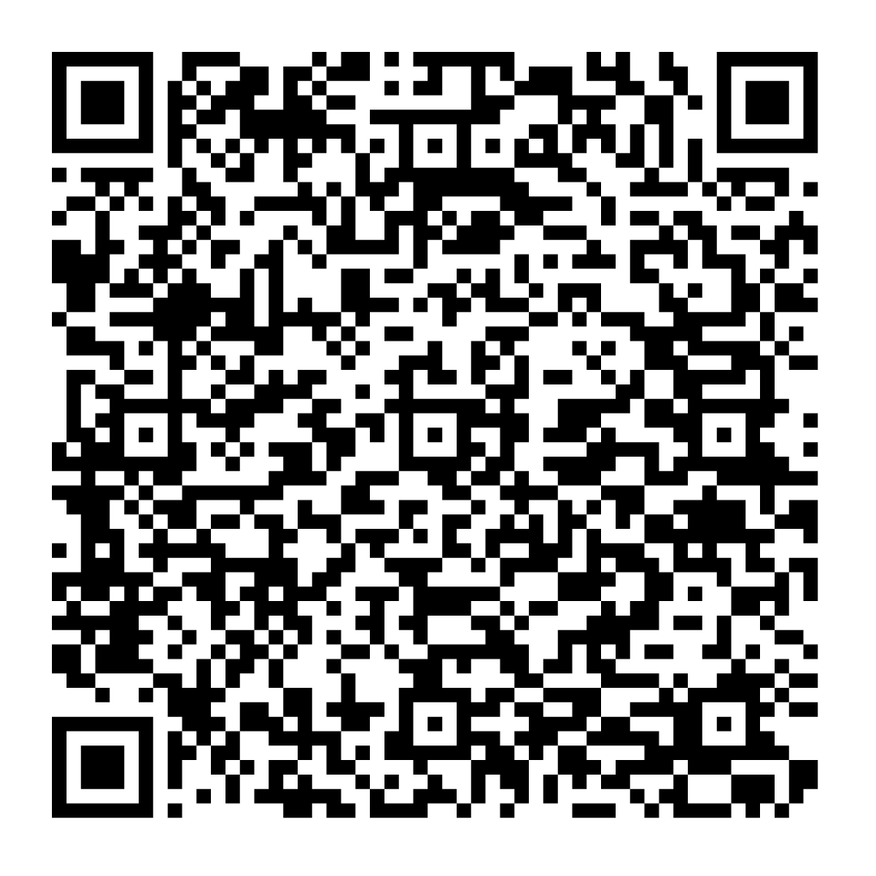
Documents
Delivering on the EU strategy on the rights of the child
Factsheet
Comprehensive package on integrated child protection
Commission Recommendation on integrated child protection systems
Communication, Annex with existing relevant EU support
(legislative, policy actions, funding)
Staff Working document
Consultation
1,095 children via the EU Children’s Participation Platform
FRA Mapping of national child protection systems
Call for Evidence and Open Public Consultation
EU Network for Children’s Rights
(Member States, international and civil society organisations)
ISC, ISG on children’s rights and JUST contact group – Thank you!

Slide 16

Policy background (continued)
LGBTIQ Strategy
EU Anti-racism action plan 2020-2025
EU Roma Strategic Framework for Equality, Participation and Inclusion 2020-2030
Strategy on the rights of persons with disabilities 2021-2030

Slide 17

Priorities of 2025 DAPHNE call
Combating gender-based violence and violence against children (DAPHNE 2025 call):
4 Priorities – Total budget available: 23 M EUR
Large-scale and long-term actions with re-granting (10 M EUR)
Protection and support to victims and survivors of gender-based violence (4 M EUR)
Prevention of gender-based violence (4 M EUR)
Targeted actions making integrated child protection systems work in practice (5 M EUR)

Slide 18
Large-scale and long-term actions with re-granting
Objectives
Reach out to grassroot civil society organisations (CSOs) active in preventing and combating gender-based violence
Build the capacity and sustainability of these CSOs (coaching, knowledge building, thematic trainings etc)
Promote and ensure respect of EU values

Slide 19
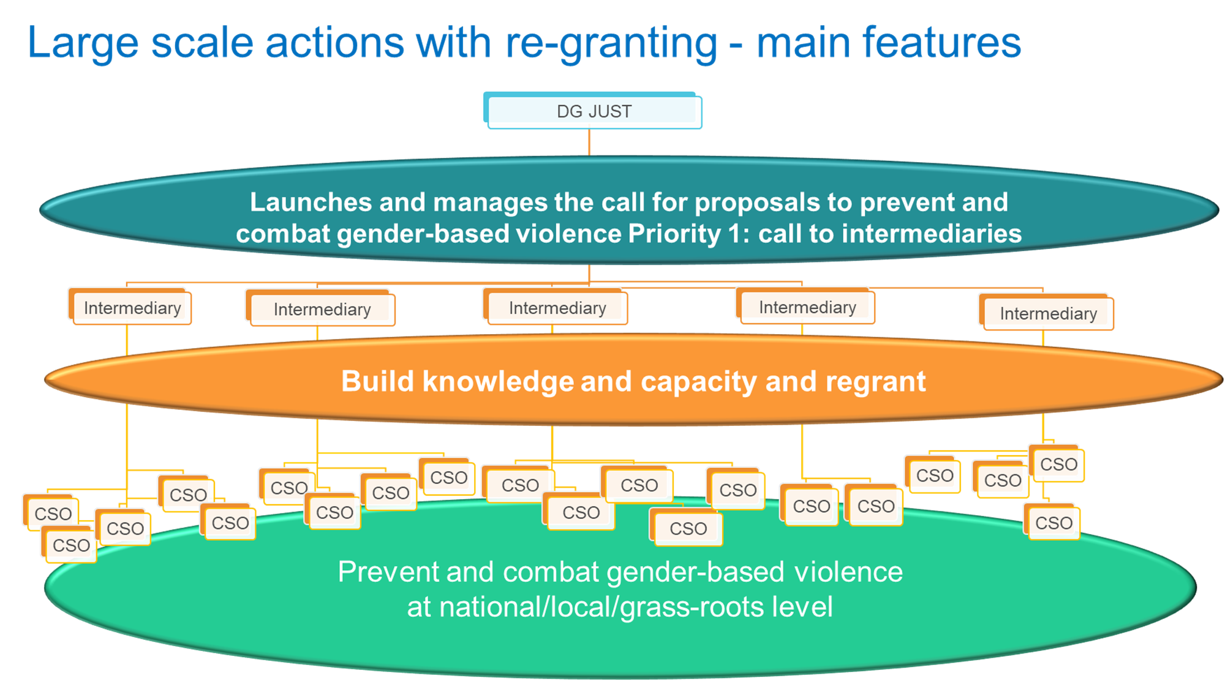

Slide 20
Large-scale and long-term actions with re-granting
Wide thematic coverage – CSOs active in preventing and combatting diverse forms of gender-based violence, in particular:
Domestic violence and sexual violence - victim-centered and trauma-informed
services, access to justice, increased accessibility of shelters or other interim accommodation (Art. 30 of VAW/DV Directive)
Gender-based cyber violence - incitement to violence or hatred, cyber stalking, cyber harassment and bullying, non-consensual sharing of intimate or manipulated material, sextortion, grooming
Harmful practices – FGM, intersex genital mutilation, forced abortion, forced sterilisation, child and forced marriage, honour-related violence, gynaecological and obstetric violence

Slide 21
2. Protection and support to victims and survivors of gender-based violence
Support the setting up/some activities of one-stop shop (in person and/or online) or coordinated specialist support centres (Art. 25 of VAW/DV Directive)
Setting up easily accessible rape crisis or sexual violence referral centres (Art. 26 of VAW/DV Directive)
Tackling the need for immediate protection and support faced by victims of sexual and domestic violence, to prevent femicides, and allow effective investigation and prosecution:
  Examples - tools to help authorities to swiftly identify, address domestic violence (Art. 15), initiate individual assessment of risk from offender (Art. 16), guidelines to identify enhanced protection/support needs for victims of intersectional discrimination (Art. 21(g))

Slide 22

3. Prevention of gender-based violence
Measures to prevent rape and to promote the central role of consent in sexual relationships (Art. 35) - involve men !
Prevention of cyber violence - strengthen digital literacy skills of online users (Art. 34(8)), reinforce positive narratives on gender equality and role of women in public decision-making roles, prevent cyber intimate partner violence
Perpetrator programmes to prevent (re)offending
Measures to combat stereotypical portrayals of women and men in the media (Art. 36(8)), to prevent sexual harassment in film and audiovisual industry

Slide 23

4. Targeted actions making integrated child protection systems work in practice
Main features:
Actions connecting prevention, early warning, reporting, cross-sectorial support, and monitoring
Multi-disciplinary approach: cooperation between authorities and education, child protection and wide range of professionals across sectors
Starting from and responding to children’s needs
Closely involving families and children themselves
Tackling in particular :
harassment and (sexual) violence, in the formal and informal educational context, community or recreational activities, in the domestic context
online and offline bullying, at school or in leisure activities, affecting children with specific vulnerabilities or at risk of discrimination
The involvement of a public authority in the consortium is compulsory

Slide 24
Types of activities to be funded
Awareness-raising, communication, dissemination (Priorities 1 and 3)
Capacity building and training for professionals, relevant stakeholders, CSOs (Priorities 1 and 2)
Design and implementation of strategies, protocols, development of transferable working methods and tools (Priorities 1 and 2)
Design of services and measures improving access to victim support services (Priorities 1 and 2)
Development of resources, toolkits and manuals to provide practical guidance for specialised support services (Priority 2)
Exchange of good practices (Priorities 1, 2 and 3)
Analytical activities, data bases/data collection (Priorities 1, 2 and 3)

Slide 25
Types of activities to be funded (priority 4)
Prevention through awareness raising activities, training of professionals;
early identification and reporting, strengthening referrals between relevant national actors;
early multidisciplinary support, through integrated response activities, close coordination between authorities and actors at all levels;
early setting up accountability mechanisms based on indicators, evaluation, data collection, self-monitoring and evaluation tools.

Slide 26
What we look for in proposals
Direct response to the call notice, clear rationale linking to relevant EU policies
Clearly defined and realistic project’s objectives, translating into concrete activities supported by a clear methodology and in practical and useful outputs
Potential for impact on well-defined target groups with explanation of outreach
Strong monitoring and evaluation plan
Meaningful partnership composition (encouragement of participation of public authority)
Sustainability prospects, measurable impact
Good value-for-money projects
Building on previous efforts (no duplication), taking into account emerging issues, geographical areas not covered yet

Slide 27
Questions?

Slide 28
Evaluation Timeline
Deadline for
Submission
7 May 2025
17:00 CET
(Brussels time)
Evaluation
May – October 2025
Information on Evaluation Results
November 2025
Grant Signature
January – February 2026
Section 4. Timetable and deadlines – page 26

Slide 29
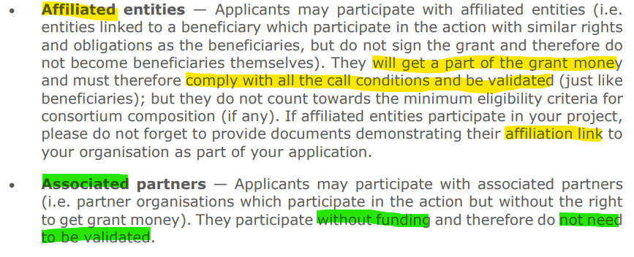
Eligibility: Who can apply?
Section 6. Eligibility – page 28
Applicants must be legal entities (public or private) or international organisations
Lead applicant must be non-profit
Private for profit only as co-applicant
Activities must take place in any of the eligible countries
P2, 3, 4: at least two applicants (lead applicant + at least one co-applicant, not associated or affiliated):
NB
International organisations may be registered outside eligible countries, but they must implement their project in the eligible countries
Section 13. Important – page 43

Slide 30
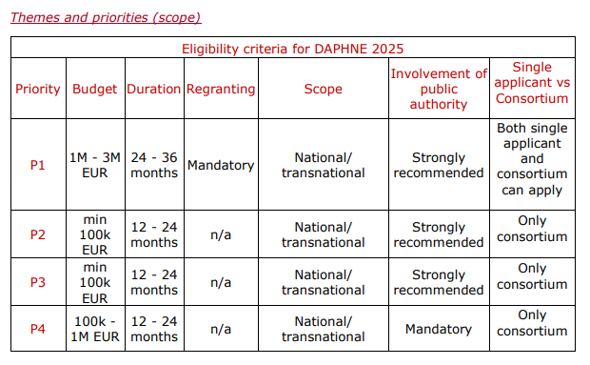
Eligibility:
Differences among Priorities
Section 2. Objectives — Themes and priorities — Activities that can be funded - Expected impact – page 9 (recap table)
P1: single applicants also allowed
P4: involvement of Public Authority is mandatory
Budget:
  1 M – 3 M EUR P1
  Min 100k EUR P2, P3
  100K – 1 M EUR P4
Duration of the project:
  12 – 24 months P2, P3, P4
  24 – 36 months P1

Slide 31
Proposal structure
Your application must be readable, accessible and printable
To be downloaded
Part A
Part B
Detailed Budget Table
Part C (KPI tool)
Administrative info
To be filled in directly online
To be filled in directly online
Description of the action
Download template
Fill in into Word
Convert into PDF
Upload PDF
Download template (LS type II), fill in & upload (.xlsx format)

Slide 32
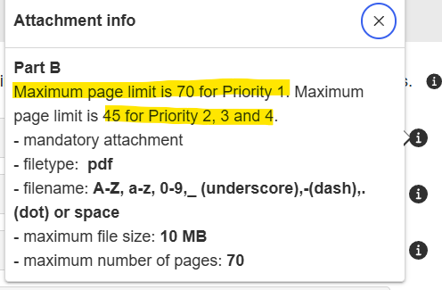
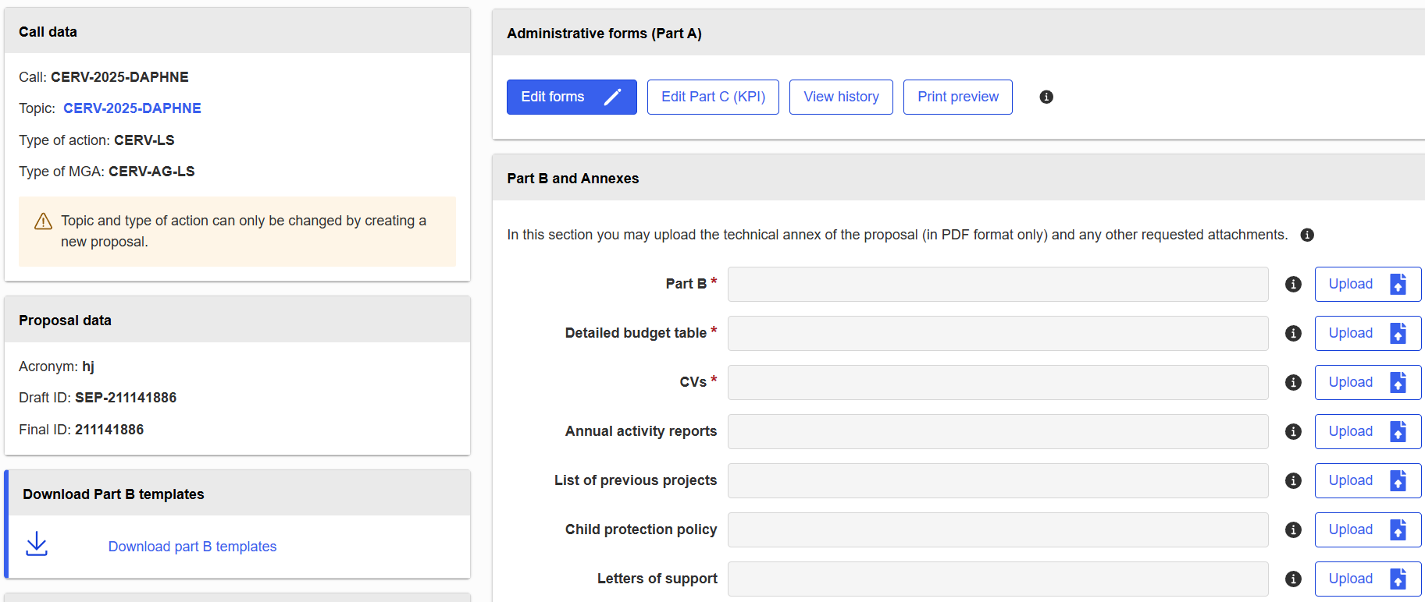
Proposal structure
.xlsx format
Download, fill in and convert into pdf
The application is evaluated as a whole – information should be coherent in all parts of the proposal
E.g. SAME REQUESTED AMOUNT in Part A and in detailed budget table!!

Slide 33
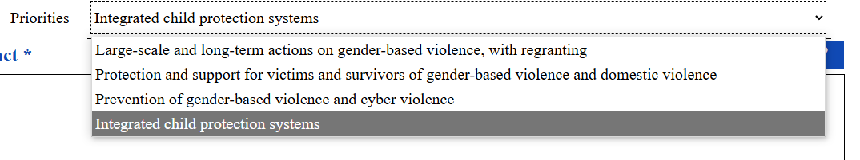
Proposal structure
Part A: remember to select ONE priority from the drop-down menu

Slide 34
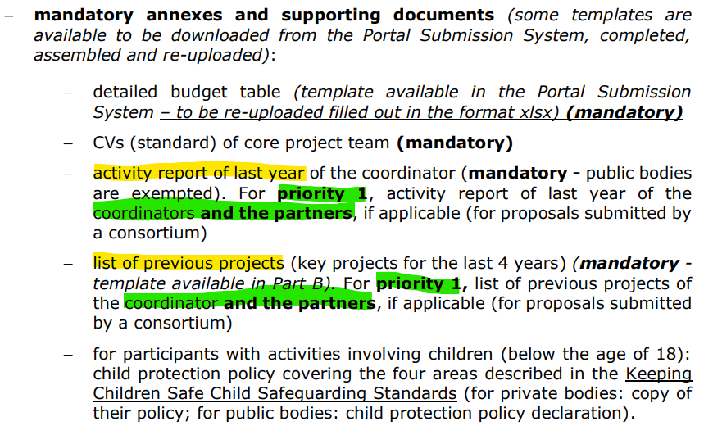
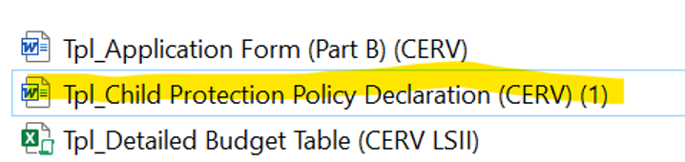
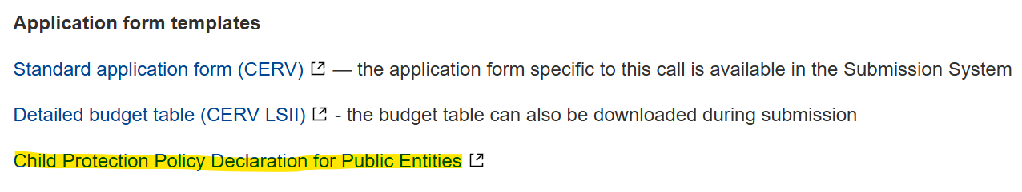
Annexes
CVs (if not available yet, at least provide ToR)
Annual Activity Report
List of previous EU funded projects
Letter(s) of support
Child protection policy in case children are directly involved → a fully-fledged CPP is needed. A template for a Declaration on Honour for public authorities is available when downloading Part B templates during the application process, or can be found on the F&T Portal under the section Topic conditions and documents > Application form templates)

Slide 35




Key figures: CERV-2024-DAPHNE
AVAILABLE BUDGET: 24.8 M EUR
Submitted proposals
498
Awarded proposals
30
Success rate
6 %
Average requested
EU grant
570 k EUR
1.8 M EUR (P1)
Budget consumption
101%*
*total current surplus: 297 k EUR

Slide 36
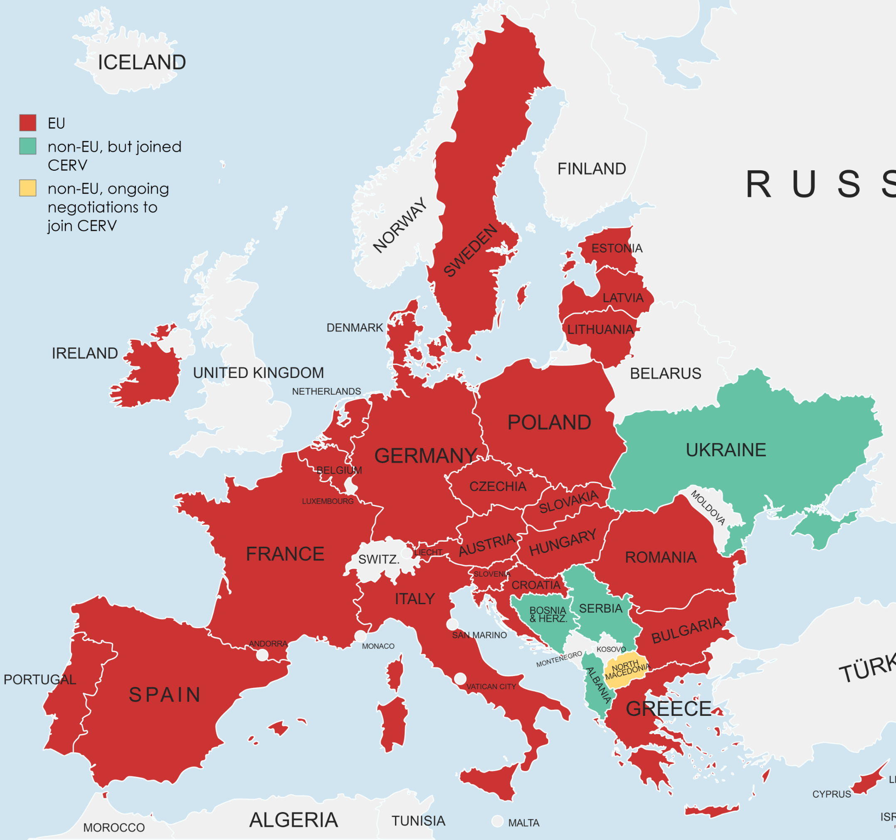
Coverage: CERV-2024-DAPHNE

Slide 37
Success rates over the years
Year | Call budget (million €) | Number of proposals submitted | Number of projects selected | Success rate %
2017 (REC) | 12,7 | 180 | 30 | 16,7
2018 (REC) | 13,3 | 213 | 39 | 18,3
2019 (REC) | 11,7 | 168 | 26 | 15,5
2020 (REC) | 12,4 | 182 | 34 | 18,7
2021 (CERV) | 17,7 | 154 | 40 | 26
2022 (CERV) | 30,5 | 269 | 46 | 17
2023 (CERV) | 24.9 | 80 | 13 | 16,3
2024 (CERV) | 24.9 | 498 | 30 | 6
Call has become more competitive: lower budget vs double amount of proposals

Slide 38
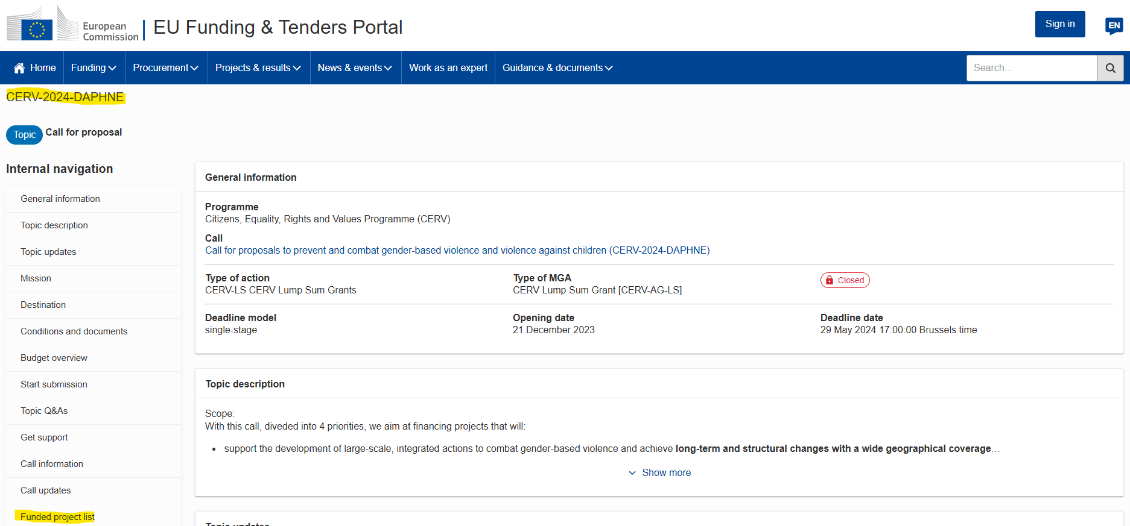
Where to find info: EU Funding & Tenders Portal

Slide 39
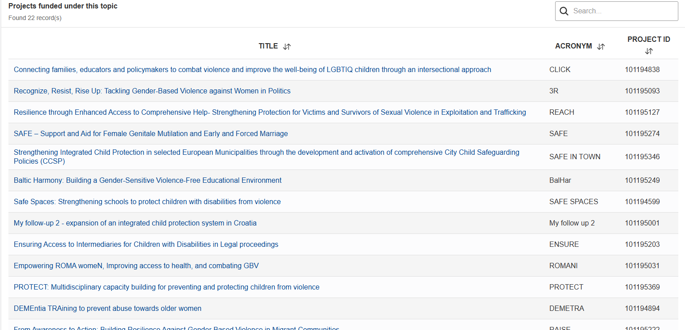

Slide 40
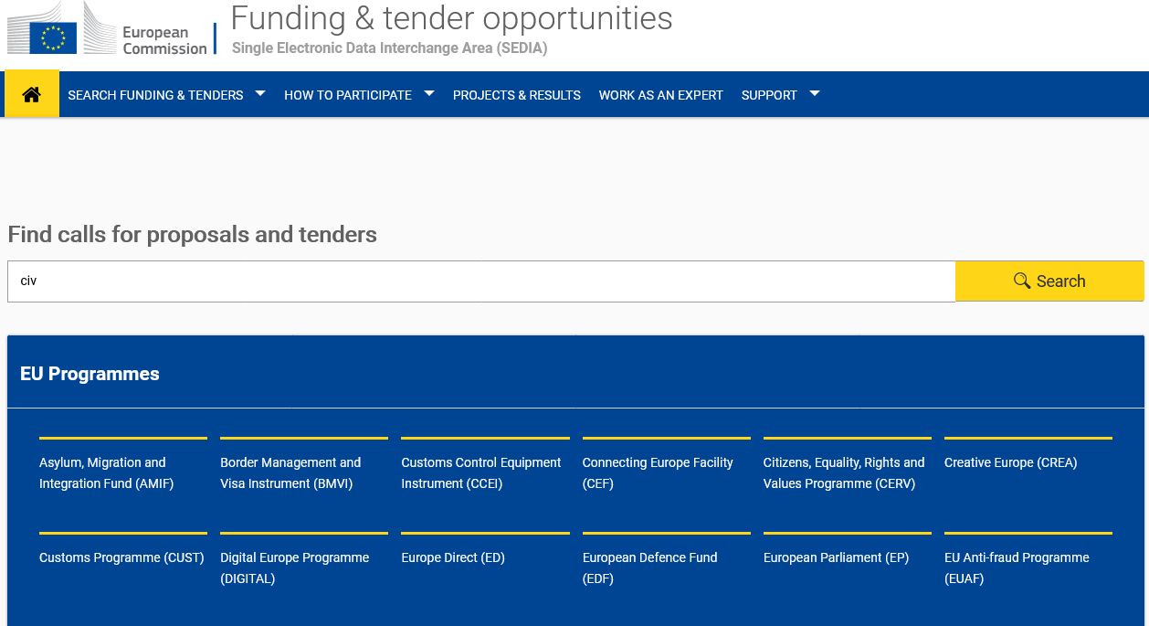
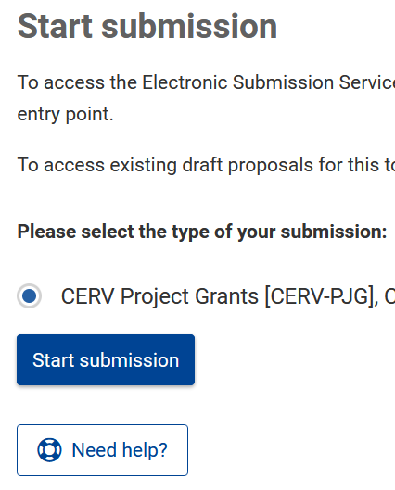
How to apply
Find the call here: EU Funding & Tenders Portal | EU Funding & Tenders Portal
Call ID: CERV-2025-DAPHNE
Notes:
KL

Slide 41
Award criteria
MAX SCORE
100 POINTS
1. Relevance (40 points)
2. Quality (40 points)
3. Impact (20 points)
Minimum pass score: 25 points
Minimum pass score: n/a
Minimum pass score: n/a
MIN PASS SCORE
70 points
Notes:
Applications assessed against 3 award criteria
Relevance of the project – 40 Points
Quality of the project – 40 Points
Impact – 20 Points
PLEASE CHECK the award critera in the Call doc
Maximum points: 100 points
Individual threshold for the criterion ‘Relevance’: 25/40 points.
Overall threshold: 70 points.
Proposals that pass the individual threshold for the criterion ‘Relevance’ AND the overall threshold will be considered for funding — within the limits of the available call budget.
Other proposals will be rejected.
2 Evaluators per proposal + 1 Rapporteur for the Consensus Report
+ Use of Vice Chairs
Mention the « gender mainstreaming » aspect (3 catégories)

Slide 42
What is a successful proposal?
Impactful: concrete targets and results​
Realistic objectives​
Responsive/engaged coordinator
Original (a new angle)​
Indicators set by age / disaggregated by gender
Transnational is an added value
Build on existing good practice : concrete multiplier effect
Written in simple way
Budget needs to correspond to the activities and specifiy in "Comments" worksheet
Notes:
Indicators should be set by age of the target group(s) and disaggregated by gender. Applications should indicate how many children (boys and girls, below 18 years old) will directly benefit from the project, the breakdown of their ages and how applicants plan to set appropriate targets for the age groups they seek to engage.

Slide 43
What do we mean by EU values?
Article 2 of the Treaty on European Union
“Respect for human dignity, freedom, democracy, equality, the rule of law and the respect for human rights, including the rights of the persons belonging to minorities.
These values are common to the Member States in a society where pluralism, non-discrimination, tolerance, justice, solidarity and equality between women and men prevail.”
Article 21 of the EU Charter of Fundamental Rights
“1. Any discrimination based on any ground such as sex, race, colour, ethnic or social origin, genetic features, language, religion or belief, political or any other opinion, membership of a national minority, property, birth, disability, age or sexual orientation shall be prohibited.
2. Within the scope of application of the Treaties and without prejudice to any of their specific provisions, any discrimination on grounds of nationality shall be prohibited.”

Slide 44
How can you show adherence to EU values
Internal
External
Past/ongoing projects
What projects have you carried out to promote non-discrimination and EU values? Have these projects advanced EU values particularly Non-discrimination?
Internal policies - What have you done to promote non-discrimination in your own organisations?
External - What kind of advocacy actions have you done in favour of EU values esp. non-discrimination?

Slide 45
Integrating a gender perspective
into projects
Introduction to Gender Mainstreaming
Gender analysis | EIGE (europa.eu)
Needs assessment
Monitoring & Evaluation
Implementation & Dissemination
Are project objectives designed, based on a robust analysis and aligned to strategic gender needs?
Are women’s needs in the area of your project the same as those of men?
Have men and women been consulted to identify needs and opportunities?
Are people from all gender involved in the monitoring and evaluation?
Are indicators to measure project progress and goals gender sensitive?
Does your data collection and interpretation approach allow to capture gender differences?
Are any gender specific factors (location, mobility, care work) limiting participation in the project?
Are there specific changes introduced by the project and would they impact women and men?
Is the project using gender sensitive language?
Notes:
Where is this gender in the call? Quality?
Why you should pay specific attention to gender mainstreaming in your proposal?
To provide you with a wider context, the Commission has revised its evaluation methodology and mainstreamed gender across the evaluation criteria to ensure that funding creates a strong added value for everybody involved in funded projects. Your attention to gender mainstreaming has an impact on the score you receive in the evaluation.
Integrating a gender perspective in the design and implementation of your project increases the quality of your proposal by ensuring that women, men, boys and girls in all their diversity benefit from your intervention in a non-discriminatory way.
In this slide there are some indications how you can make sure to integrate the gender perspective in your proposal.
Overarching and guiding questions
Who is the target (both direct and indirect) of the proposed project? Women, men or both? Who will benefit, who may lose? Which women? Which men?
•Have women and men who are challenged by a certain issue been consulted about its solution? How have they been involved in the development of the solution?
•What specific mechanisms can be proposed to encourage and enable people of a underrepresented gender to participate in the project?
•Who has and does what? (access and control of resources, time and location of activities, decision making)
•What is the influence of the socio-economic and cultural context on the design and implementation of the project?

Slide 46
Questions?

Slide 47

REA Central Validation Service
Getting started - Registering your organization
Maria Carneiro
Senior Assistant- Participant Validation
Notes:
MARIADOMENICA CUGNIDORO

Slide 48
Presentation Outline
REA Central Validation Service
Registration of participants
Legal validation and Legal entity appointed representative (LEAR)
Communication
Guidance documents

Slide 49
REA Central Validation Service
(REA CVS)
Verifies legal existence and legal statuses of entities
Validates the appointment of Legal Entity Appointed Representatives (LEARs)
Validates legal changes of validated entities
Assesses universal takeovers (UTROs) of validated entities
Encoding Bank Account requests
Prepares the Financial Capacity Assessment
Performs ownership control assessments for specific programmes
Performs ex-post status verifications (e.g. SME & MID cap status checks)

Slide 50
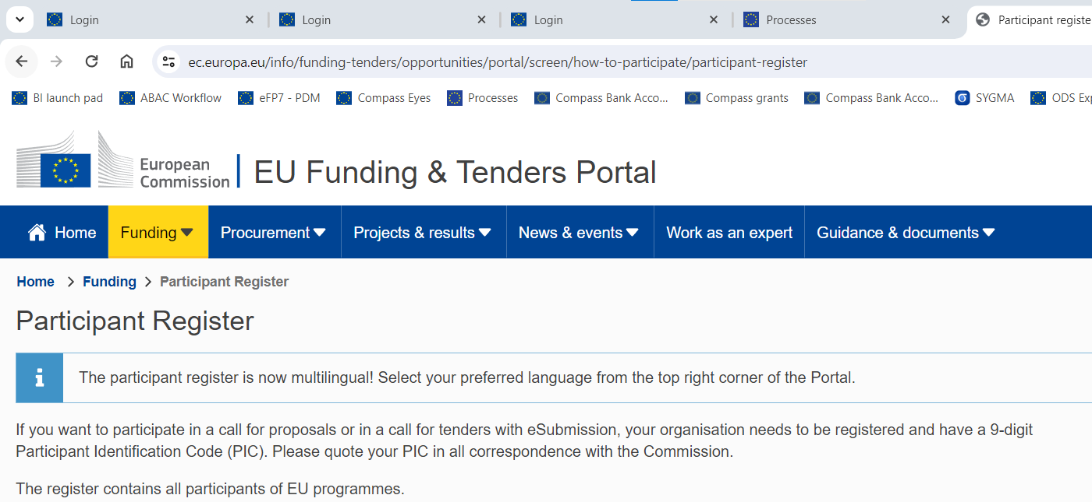
Registration of an organisation
(at proposal stage)

Slide 51
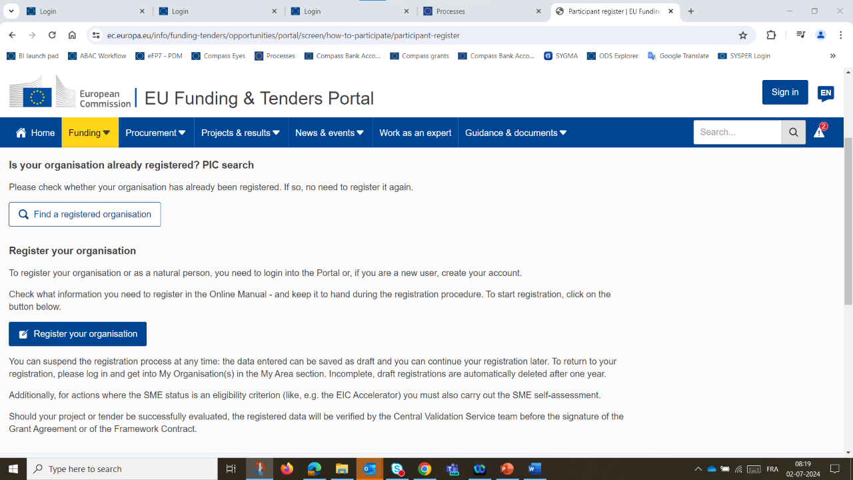
Registration of an organisation
(at proposal stage)
Search for a registered organisation
New registration

Slide 52
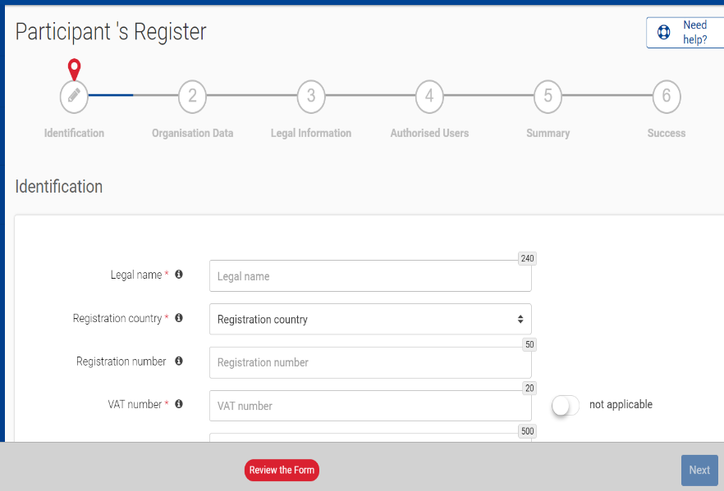
How to register in the Participant Register
Identification
(e.g. Legal name, VAT number)
Organisation data
Legal information
Authorised users
Registration completed
(e.g. Name, e-mail address of the self-registrant and the back-up)
New Participant Identification Code (PIC) in a “declared” status

Slide 53

Validation Process Overview
Organisations have to register in the Participant Register
Financial Capacity Assessment if needed
Mandatory for all validated participants
Based upon
legal documents
Mandatory
COMMUNICATION VIA PARTICIPANT REGISTER

Slide 54
Legal validation
  Registration data is verified by REA Central Validation Service before the signature of the Grant Agreement or the Contract
  The legal validation of a participant is done once, when the entity has to sign its first Grant Agreement or Contract and it is reused for future participations in EU grant and procurement actions
  Validation is always performed on the basis of supporting documents, in accordance to EU Financial Regulation and the Rules on Legal Entity Validation, LEAR Appointment and Financial Capacity Assessment for EU Grants and Tenders

Slide 55
Legal validation documents
Legal entity form (template to be completed, dated, stamped and signed)
VAT extract (< 1 year)
  If not registered for VAT – proof of VAT exemption
Registration extract (< 1 year) – for private law bodies
Law/decree/decision – for public law bodies
Treaty – for international organisations
Statutes – for non-profit organisations

Slide 56
Validation Process Overview
Organisations have to register in the Participant Register
Financial Capacity Assessment if needed
Mandatory for all validated participants
Based upon
legal documents
Mandatory
COMMUNICATION VIA PARTICIPANT REGISTER

Slide 57
LEAR role and duties
  In the Single Electronic Data Interchange Area, the appointment of the Legal Entity Appointed Representative (LEAR) is mandatory.
  The LEAR:
    Notifies the EU of changes in legal data/status
    Submits legal and financial documents if required
    Manages access rights of persons in the organisation (but not at the project level)
    Nominates 'Account Administrators' and individuals authorised to sign:
Contracts/grant agreements and their amendments (Legal signatories, i.e. LSIGN)
Financial statements (Financial signatories, i.e. FSIGN)

Slide 58
LEAR appointment documents
  LEAR appointment letter (duly signed by both the legal representative and the LEAR)
  Official proof of identity (ID-card/passport with photo and signature) of the legal representative and the LEAR
  Proof of empowerment of the legal representative
  Scanned version of these documents shall be uploaded in the Participant Register. Original of the LEAR appointment letter (1) must be kept in the entity's premises.

Slide 59
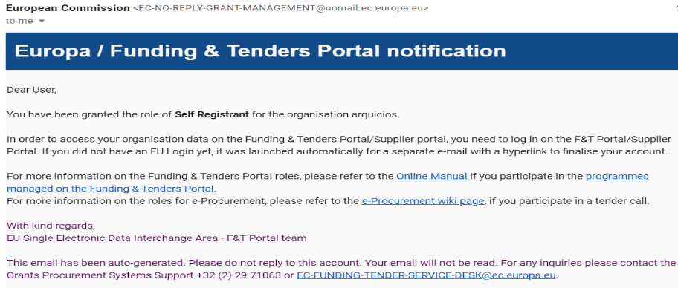
Communication
(e.g. request to submit legal documents or to appoint a LEAR)
  Messages are notified via e-mail to the contact person
  (i.e. self-registrant or the appointed LEAR)
  All communication is exclusively managed through the Participant Register

Slide 60
Access lost to a declared or valid PIC
Declared PIC
In case the self-registrant left the organisation and no one has access to a declared PIC – a new PIC needs to be created and REA CVS informed
Valid PIC
If the LEAR is not available anymore and there are no Account Administrators, a new LEAR needs to be appointed – LEAR recovery procedure
https://ec.europa.eu/research/participants/urf/lear-recovery/request/

Slide 61
Guidance documents
Rules on Legal validation, LEAR appointment and financial capacity assessment:
https://ec.europa.eu/info/funding-tenders/opportunities/docs/2021-2027/common/guidance/rules-lev-lear-fca_en.pdf
How to register in the Participant Register:
https://webgate.ec.europa.eu/funding-tenders-opportunities/display/OM/Online+Manual
Online Manual, IT How to, IT and RES Helpdesk and specific FAQs on the Funding and Tenders Portal:
https://ec.europa.eu/info/funding-tenders/opportunities/portal/screen/support/support
Legal notice on the Funding and Tenders Portal (terms and conditions, data protection):
https://ec.europa.eu/info/funding-tenders/opportunities/portal/screen/support/legalnotice

Slide 62
Thank you for your attention!
Questions?

Slide 63
Lump sums
Specific budgetary aspects
Maria STERNATIVO - Project Manager
JUST H3 - Budget, Programmes and Financial Management

Slide 64

Evolution of funding in DG JUST
Before 2019
2019
2021
2023
Lump sums
Actual costs and detailed costs declaration
Actual costs and use of resources
Actual + Unit costs
and use of resources

Slide 65
Definition
Lump sum funding is one of the forms of Union contributions.
The amounts are determined up-front and fixed;
Payment is not triggered by the costs actually incurred, but it is based on the implementation of the activities.

Slide 66
Two types
Type II
bottom-up
(CERV-2025-DAPHNE)
The applicants define the lump sum in their proposal in line with the activities to carry out;
Type I
top-down
The European Commission decides the lump sum up-front in the call for proposal;

Slide 67

Why? Focus on outputs
Focus on content and quality
clear objectives and outputs
Easier access to the programme for beneficiaries with limited experiences
less financial management
simplified records-keeping
IMPLEMENTATION
COSTS
Notes:
=

Slide 68
Simplification
No costs reporting
No costs-supporting documentation
No ex post financial audits
Ex-ante cost evaluation
faster payments
EX ANTE
EX POST
Notes:
=

Slide 69
What changes with LS II?
Focus on completion of work packages
Payment depends on completion of activities
No costs justification at payment stage
! No financial ex-post audits

Slide 70
What does not change:
Calls for proposals
Admissibility / eligibility conditions
Reporting periods and technical reporting
Evaluation / award criteria
Eligible activities, Eligible costs
Rate of EU funding – 90%
Payment arrangements: pre-financing, interim/final

Slide 71
Payment arrangements
The reporting and payment arrangements are fixed in the Grant Agreement
After grant signature, you will normally receive a prefinancing to start working on the project (float of normally 80% of the maximum grant amount; exceptionally less or no prefinancing).
Payment of the balance: At the end of the project, we will calculate your final grant amount. If the total of earlier payments is higher than the final grant amount, we will ask you (your coordinator) to pay back the difference (recovery).

Slide 72
How to write a proposal

Slide 73
Writing a proposal with Lump sum Type II
1. Well structured work plan and solid methodology
Clear objectives, measurable and achievable outputs
Describe activities in detail and define deliverables in each work package
Clear division of tasks
(Objectives > Tasks and activities > Deliverables)
2. To define the lump sum, you must correctly fill in a detailed budget table with cost estimations. Mandatory annex to the proposal – provided in the submission system

Slide 74
Definition of Work Packages
What’s a work package?
A work package (WP) is a major sub-division of the work plan of your project.
What’s NOT a work package?
A single activity, single task (desk research) or percentage of progress (e.g. half-research)
A lapse of time is generally not a WP (e.g. activities of year 1)

Slide 75
WPs split?
Most of our projects have only 1 periodic report.
Splitting WPs is entirely optional, it should be used if needed to optimize cash flow.
In our grants, you normally receive already 80% EC contribution as pre-financing. No need to split WPs.

Slide 76
Importance of the Work Packages
The completion of a work package will trigger the payment
Partial implementation → partial payment
It is important to have well drafted work packages with detailed tasks and quantifiable, measurable outputs (i.e. deliverables).
Projects should normally have a minimum of 2 work packages.
Each work package must have deliverables (e.g. around 4-5 deliverables per WP).
The completion of a work package is assessed based on the implementation of its deliverables.

Slide 77
Importance of deliverables
Deliverables = monitoring tool for project implementation
Around 4-5 deliverables per work package
Schedule – due dates
Intervention logic: solid work plan
Clear objectives > tasks and activities > measurable and quantifiable deliverables (coherent with Part C)
(Indicators: N. participants, attendance signed sheets, reports, agenda, pictures…)
Information is coherent and reported in detail;
EU visibility rules;
Implementation of deliverables → implementation of work package > payment

Slide 78

Approximation of actual costs
The budget is the best estimate of the actual eligible costs, necessary to implement the action and justified by the activities proposed.
In the detailed budget table, you provide cost estimations for each cost category per beneficiary and per work package.
They must be as close as possible to reality (NO costs inflation)

Slide 79

The detailed budget table
Cost estimations are subject to the same eligibility rules:
must be reasonable/not excessive
must be in line with and necessary for the activities proposed
must be in line with beneficiaries’ normal practices
in compliance with applicable national laws
The EC supporting tool for fixing the lump sum
accuracy of cost estimation
Easy-to-use
Based on units and costs per unit
Mandatory annex to the proposal
Not part of the grant agreement

Slide 80
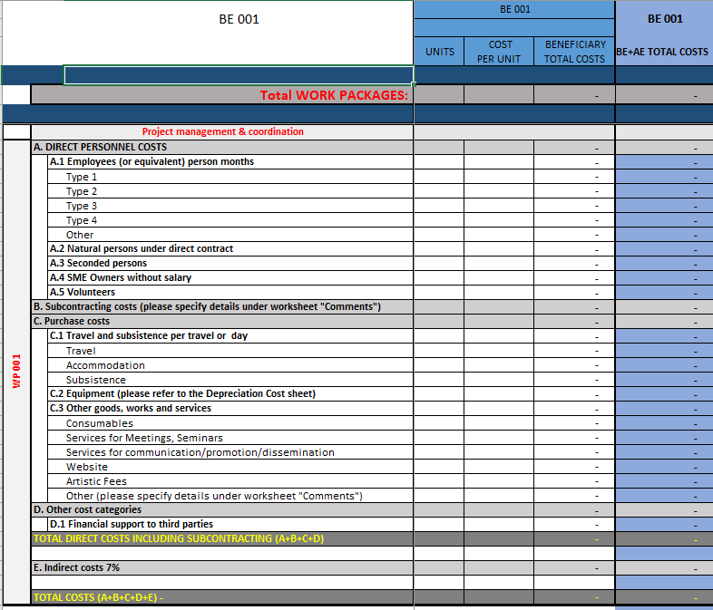
Basic principle: the detailed budget table is based on units
Cost estimations are calculated by multiplying the cost per unit with the number of units

Slide 81

Grant Agreement
The costs estimations encoded in the detailed budget table are used to fix the lump sum in the grant agreement.
The breakdown of lump sum shares per beneficiary and per work package is included in the grant agreement (Annex 2).
The detailed cost estimations (i.e. budget categories) from your proposal do not become part of the grant agreement.
Once the lump sum is fixed in the grant agreement, the costs actually incurred are not relevant.
If a work package is incomplete at the end of the project, the lump sum is paid partially in line with the degree of completion. This amount is determined after a contradictory procedure.
No financial audits – in case of audits, supporting documents must prove the proper implementation of the work and achievements of results (see Article 20)

Slide 82
Grant Agreement
General eligibility conditions for lump sum contributions:
(i) they are set out in Annex 2
(ii) the work must be properly implemented by the beneficiary in accordance with Annex 1
(iii) the deliverables/outputs must be achieved in the period set out in Article 4 (with the exception of deliverables/outputs relating to the submission of the final periodic report, which may be achieved afterwards; see Article 21)

Slide 83
Budget flexibility and amendment
You can use the budget as you see fits best your needs, as long as the project is implemented as agreed.
Transfers of LS share between beneficiaries and work packages don’t require an amendment.
The actual distribution of the lump sum is invisible to the EC
However, it might be in the interest of the consortium to reflect such changes in Annex 2.
If a change of activities (Annex 1) implies a change of the LS contribution by work packages, you should consequently change Annex 2.

Slide 84

LS TYPE II – PAYMENT
The payment of the lump sum depends on the degree of implementation of the work package.
A work package fully implemented → the lump sum is fully paid INDEPENDENTLY of the actual costs incurred for the work package .

Slide 85

WP1 – 10% of costs
Pay attention in how you estimated the costs of WP1 Project management and coordination
No inflation of WP1 - less financial management due to lump sums, no financial audit, records keeping as before (no timesheets, boarding passes). 10%
For example, given the simplification introduced with LS, the financial coordination of the project requires less administrative burden, hence less human effort under WP1.

Slide 86
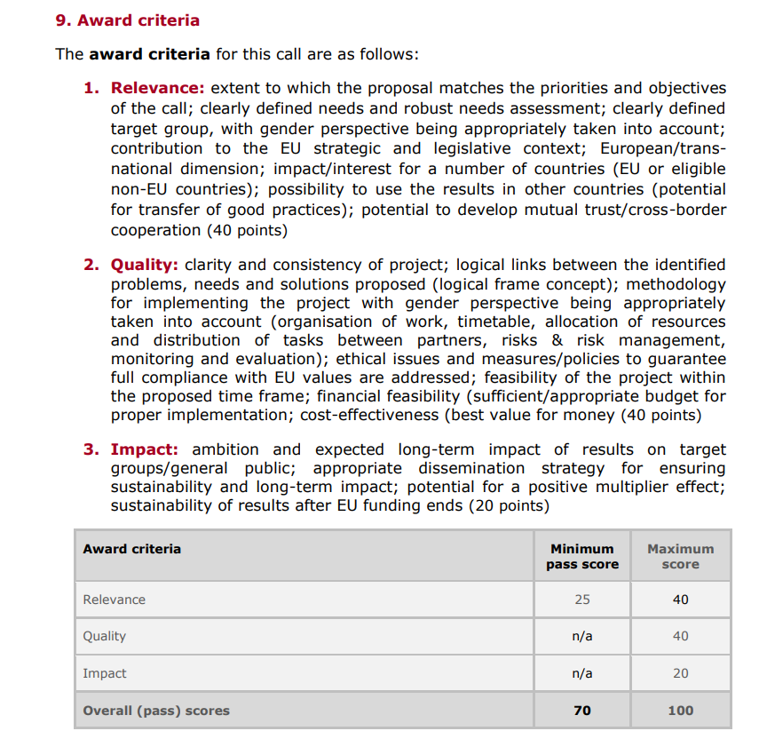
Project evaluation
No changes in the evaluation of the proposal
Standard criteria → Relevance, Quality and Impact
Budget is evaluated under the quality criteria.
Its evaluation can be based on benchmarks (historical data, average costs per training/day, unit costs Decisions, .etc)

Slide 87
Evaluation of costs estimations
Evaluators make concrete recommendations, on the basis of which the lump sum amount and lump sum breakdown will have to be modified during grant preparation to ensure that cost estimation is reasonable and in line with the outputs and resources needed.
Possible changes to the lump sum budget following evaluation:
  removal of ineligible costs
  removal of erroneously duplicated cost items
  correction of overestimated or underestimated costs.
Changes to the lump sum budget can lead to a lower lump sum and/or to the transfer of budget between different activities or different partners.
A flawed lump sum budget should lead to a decreased score under the quality criterion (e.g. if the lump sum is clearly overestimated or underestimated, or if the budget structure is unfit for purpose).
Notes:
Possible changes to the lump sum budget following evaluation:
removal of ineligible costs (i.e. costs that do not meet the basic cost eligibility conditions in EU grants; see AGA — Annotated Grant Agreement, art. 6)
removal of erroneously duplicated cost items
correction of overestimated or underestimated costs.

Slide 88
How to estimate costs

Slide 89

Personnel costs
How to make your cost estimation
EC recommendations:
1 unit = 1-month full time for 1 person
Cost per unit = annual cost per person / 12 months
You can customize the staff categories in the detailed budget table.
The number of person-months required at each level of qualification/seniority must be in line with and justified by the activities proposed
Benchmark for personnel costs – see Horizon Dashboard
Direct personnel costs
  A.1 Employees
  A.2 Natural persons under direct contract
  A.3 Seconded persons

Slide 90
Personnel costs
How to make your cost estimation
SME owners without a salary = Persons who are directly owners or co-owners (regardless of their percentage of ownership) of the beneficiary, if the beneficiary is an SME and the person is not an employee of the beneficiary.
1 unit = 1-month full time for 1 person
Cost per unit = monthly rate
The costs must be calculated, for the SME owner, in accordance with the methodology set out in Decision C(2024) 5328 (amending Decision C(2020)7115) and Annex 2a:
In the decision, the amount per unit is expressed in daily rate! {EUR 8.745,4, multiplied by the relevant country-specific correction coefficient divided by 18 days}.
Direct personnel costs
  A.4 SME owners without salary
  A.5 Volunteers
Volunteers = persons who freely work for an organisation, on a non-compulsory basis and without being paid (Art. 6.2 CERV MGA)
1 unit = 1-month full time for 1 person
Cost per unit = monthly rate (=daily rate * 18)
The costs must be calculated in accordance with the methodology set out in the Decision C(2019) 2646 and method set out in Annex 2a.
In the decision, the amount per unit is expressed in daily rate!
Note that:
max EU contribution = Total eligible costs – volunteers.
The amount estimated as volunteers work must be less than 50% of the total eligible and ineligible costs and contributions estimated for the project.
NO indirect costs for the volunteer part in the budget.

Slide 91
Subcontracting, equipment and services
How to make your cost estimation
EC recommendations:
Subcontracting – in Part B (Technical Description) please provide clear and detailed explanations of the subcontracted action tasks, their estimated costs and of the best-value-for-money procedure to select the subcontractor.
For C.2 equipment, it is mandatory to use the worksheet ‘Depreciation costs’.
For C.3 Other goods, works and services – estimated costs must be in line with outputs.
! In the description of the proposal (Part B), make sure that activities are well described so that the evaluators can assess the link between resources (cost estimations in the detailed budget table) and the quantifiable outputs included under deliverables.
B. Subcontracting costs
C.2 Equipment
C.3 Other goods, works and services

Slide 92


C1. Travel, accommodation and subsistence : UNIT COSTS
1 travel unit = 1 person return trip
1 accommodation unit = 1 night spent on travel for the action
1 subsistence unit = 1 day spent on travel for the action (24-hour period)
C. Purchase costs
C.1 Travel subsistence and accommodation
The number of units for travel, accommodation and subsistence must be in line with the activities foreseen
Benchmark: Decision on unit costs for travel and subsistence Decision C(2024)5405 and the new rates for unit cost for travels published in the Additional information on unit costs Annex 2a

Slide 93
Travel, accommodation and subsistence
Departure: place of employment
Arrival: place where the activity takes place
Distance calculator
To cover the most frequent cases:
travels intra member states (50-400km)
Travels between member states (50-400km)
All travels above 400k
Same for accommodation and subsistence: only the most frequent destinations are listed (55/193 countries)
For all other situations (less frequent/exceptional) not covered by unit costs, you use estimated actual costs (see datasheet)

Slide 94
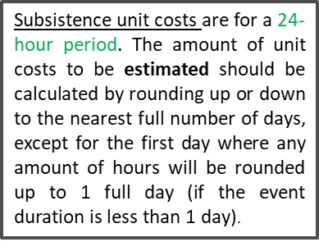
Accommodation and subsistence costs
Subsistence unit: days spent on travel for the action
Subsistence amount per unit (daily rate) in the table: ‘for calls with opening date after 31 July 2024’ page 15-16 of Annex 2a
! Only for people travelling, not for local participants
Accommodation unit: night spent on travel for the action
Accommodation amount per unit in the table: ‘for calls with opening date as from 31 July 2024’ at pages 10-11 of Annex 2a

Slide 95
ONLY Priority 1
D.1 Financial support to third parties
The maximum amount of financial support per each third party is EUR 60 000.
The maximum amount of financial support per individual regranted project is EUR 60 000.
Applicants for financial support to third parties should not be required to provide any co-financing.
Applicants for financial support to third parties should be able to use simplified cost options and in particular lump sums.
the activities must take place during the project implementation period. Only cost incurred during that period can be considered eligible

Slide 96
Detailed budget table
The detailed budget table file is protected – do not modify the formulas!

Slide 97
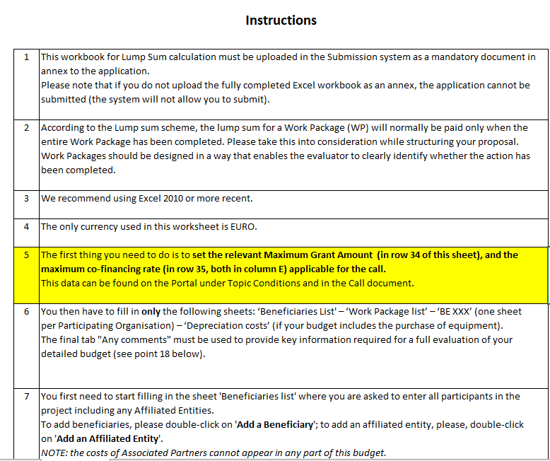
Instructions

Slide 98
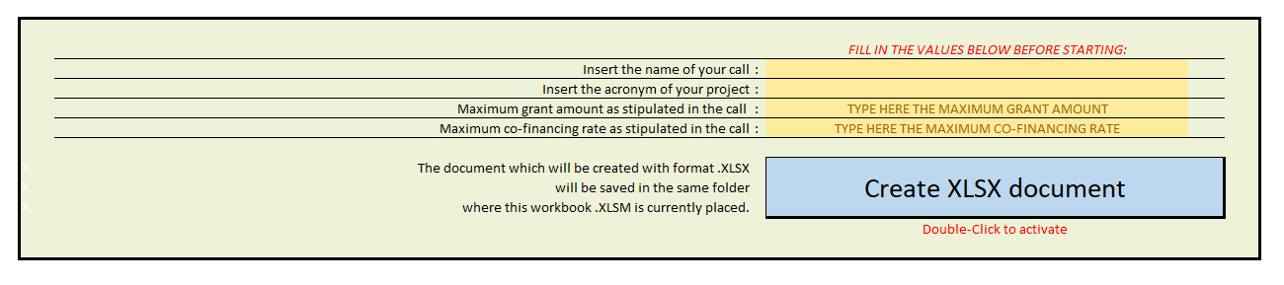
Instructions

Slide 99
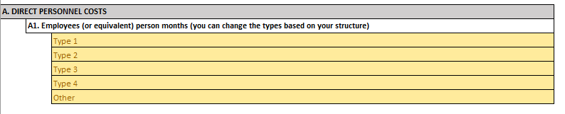
Instructions
Possibility to customize the staff categories:

Slide 100
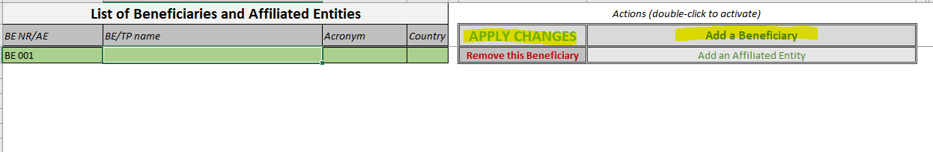
Beneficiaries list

Slide 101
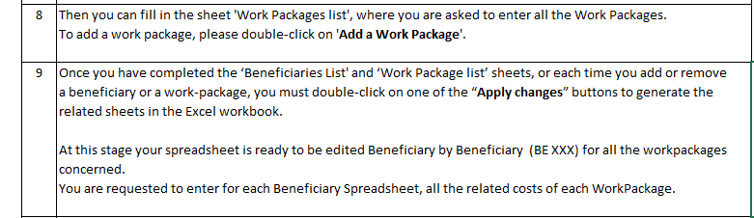
WPs list

Slide 102
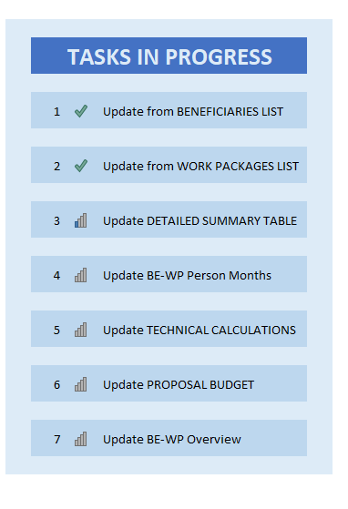
Apply changes
Once you double click «APPLY CHANGES»
you will see this box loading

Slide 103
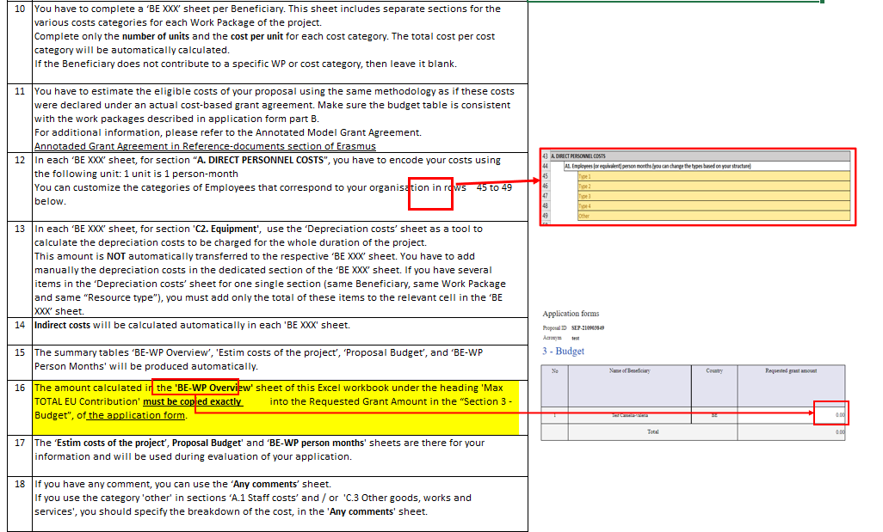
Instructions

Slide 104
Encode the estimated costs in the individual beneficiary sheets (‘BEx’ tab)
Complete one ‘BEx’ sheet per beneficiary. This sheet includes one separate section for each work package. For each work package, enter the cost estimations under each cost category used.
Enter only the number of units and the cost per unit for each cost category. The total costs per cost category is calculated automatically.
The table accepts decimals.
If the beneficiary does not contribute to a specific work package, leave the cells empty

Slide 105

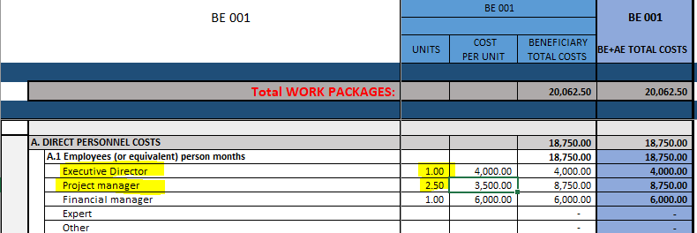
Personnel costs
How to encode in the table
Example under one Work Package:
Executive Director with annual costs of EUR 48,000 works in this WP for 1 month. For personnel costs, 1 unit is 1 person-month.
The cost per unit is EUR 4,000 (48,000 / 12 months) and the number of units is 1 (1 month). The detailed budget table will then display the estimated cost for this Executive Director as EUR 4,000 (4,000 x 1).
Project manager with annual costs of EUR 42,000 works in this WP for 2 month and a half. For personnel costs, 1 unit is 1 person-month.
The cost per unit is EUR 3,500 (42,000 / 12 months) and the number of units is 2.5 months. The detailed budget table will then display the estimated cost for this Project manager as EUR 8,750 (3,500 x 2.5).
Average

Slide 106
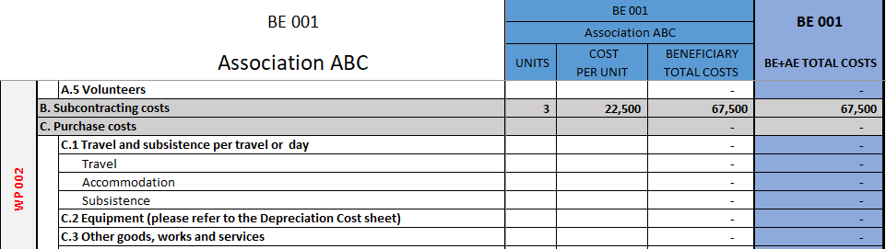

Subcontracting costs
How to encode in the table
Average
There is one line for subcontracting per beneficiary and work package (i.e., the encoded amount covers all subcontracting activities for the beneficiary in a work package).
Number of unit = number of subcontracted tasks for a given beneficiary and a given work package as number of unit.
Cost per unit = average of the costs of all subcontracted.
The tasks to be subcontracted and their costs must be described and justified in part B of the application form.

Slide 107
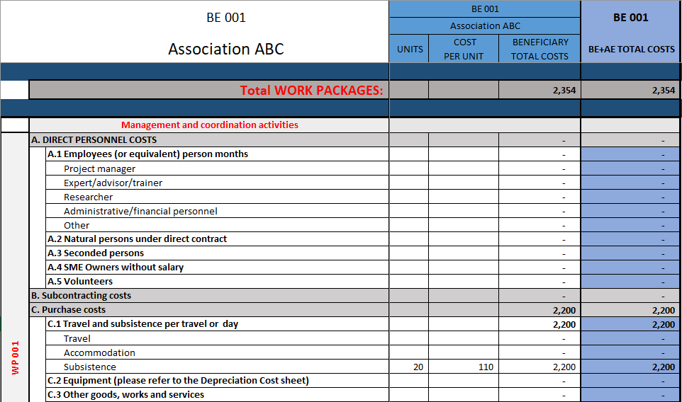

Purchase costs
How to encode in the table
If you have a cost (line) with different costs per unit, you have first to calculate an average amount in order to fill in the cells.
For example, for subsistence:
1 day meeting in ITA – 10 participants – Daily rate: 98 €
1 day meeting in DK – 10 participants – Daily rate: 124 €
The cost per unit is 110 € (average between € 98 and € 124).
N. Units = n. days spent per participant on the action (20)
Average

Slide 108
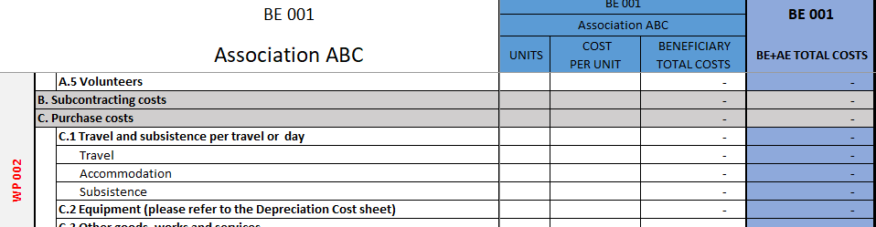
Equipment
How to encode in the table
For section ‘C2. Equipment’, use the ‘Depreciation costs’ sheet as a tool to calculate the depreciation costs to be charged for the whole duration of the project.
This amount is NOT automatically transferred to the respective ‘BE XXX’ sheet.
You have to add manually the depreciation costs in the dedicated section of the ‘BE XXX’ sheet.
Charge the depreciation costs to the relevant beneficiary and work package

Slide 109
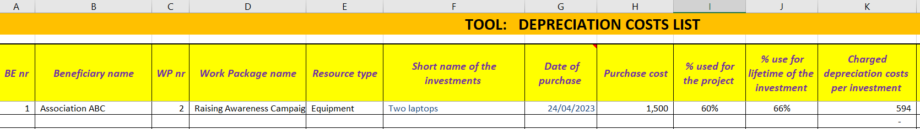
Depreciation costs worksheet
For equipment:

Slide 110

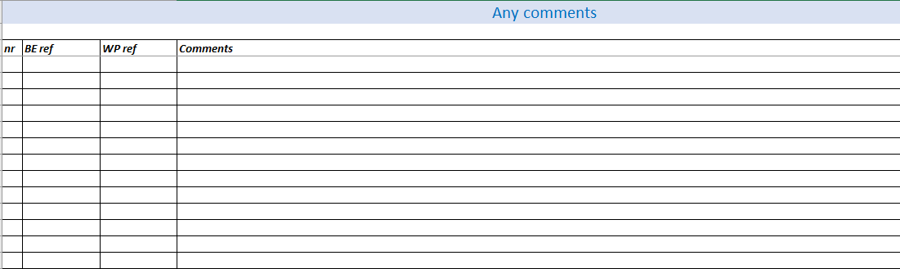
‘Any comments’ worksheet
The worksheet ‘Any comments’ allows you to explain how you estimate costs.
It refers to all budget categories (personnel costs, subcontracting, purchase costs)

Slide 111
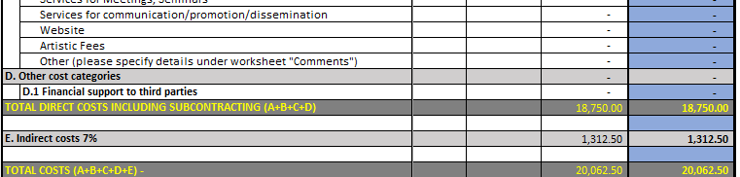
Indirect costs
Indirect costs will be automatically calculated in each ‘BE XXX’ sheet

Slide 112
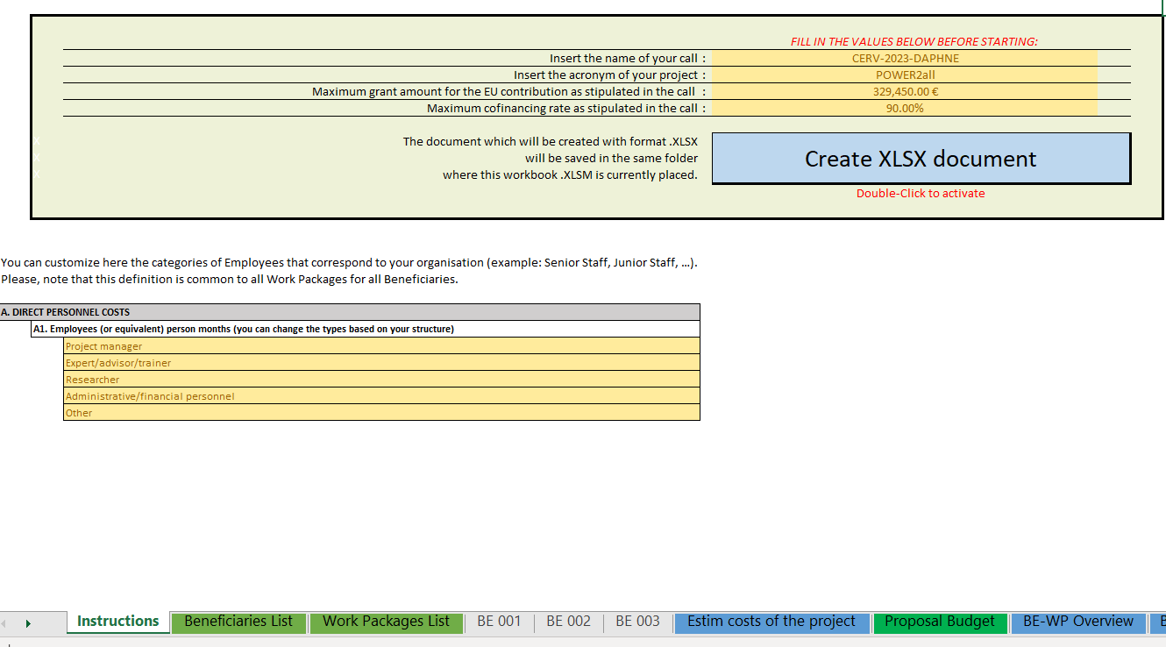
Upload the file in the application
Go back to the first tab ‘Instructions’ and DOUBLE CLICK on
‘Create XLSX document’ to save this Excel file on your computer and upload it in your application

Slide 113
Resources available
Lump sum funding in Horizon Europe >> EU Funding & Tenders Portal
Video tutorials
Guidance documents
Studies
Events

Slide 114
THANK YOU
Q&A

Slide 115

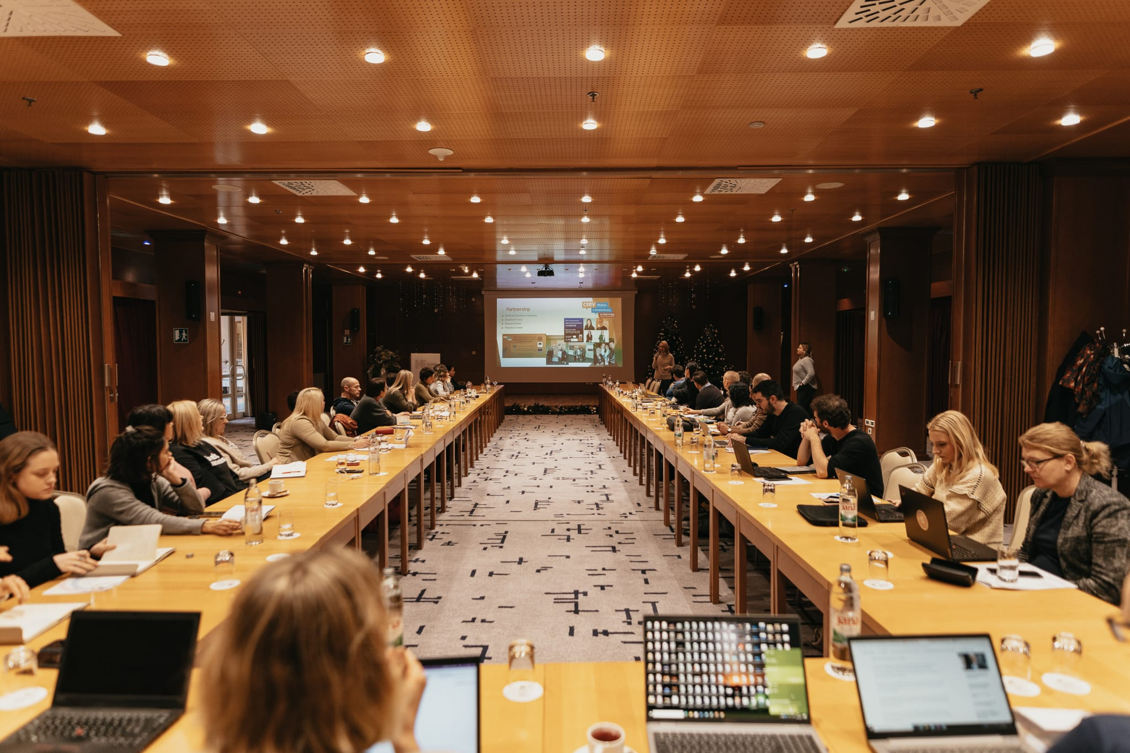
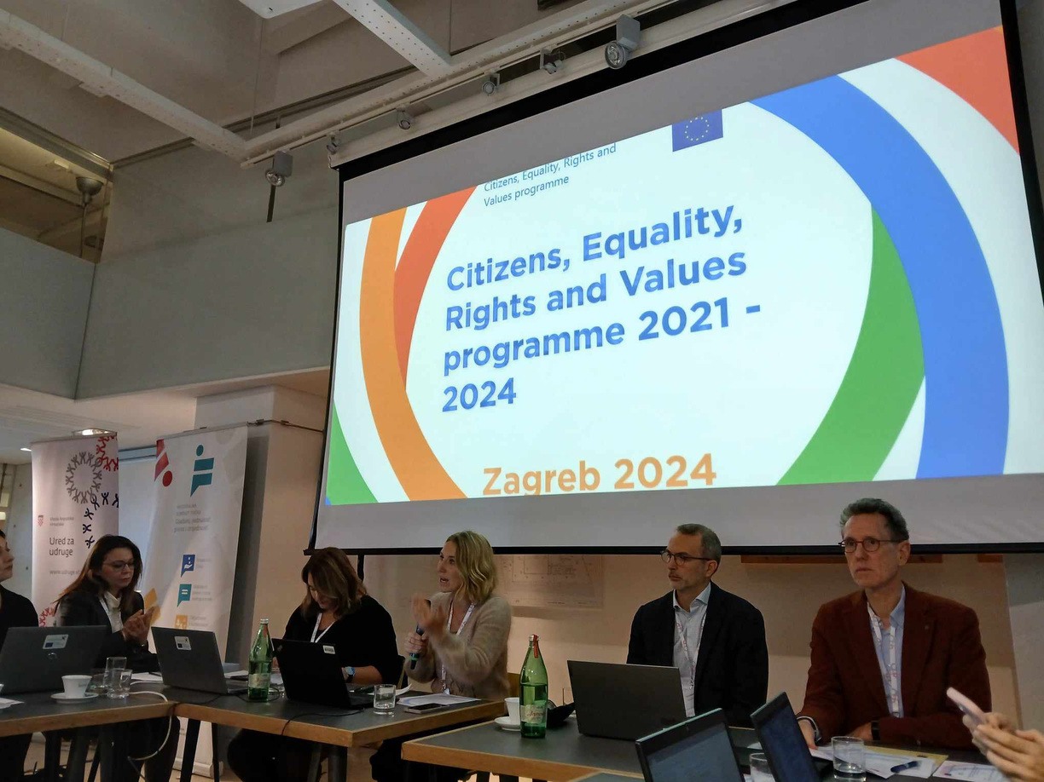
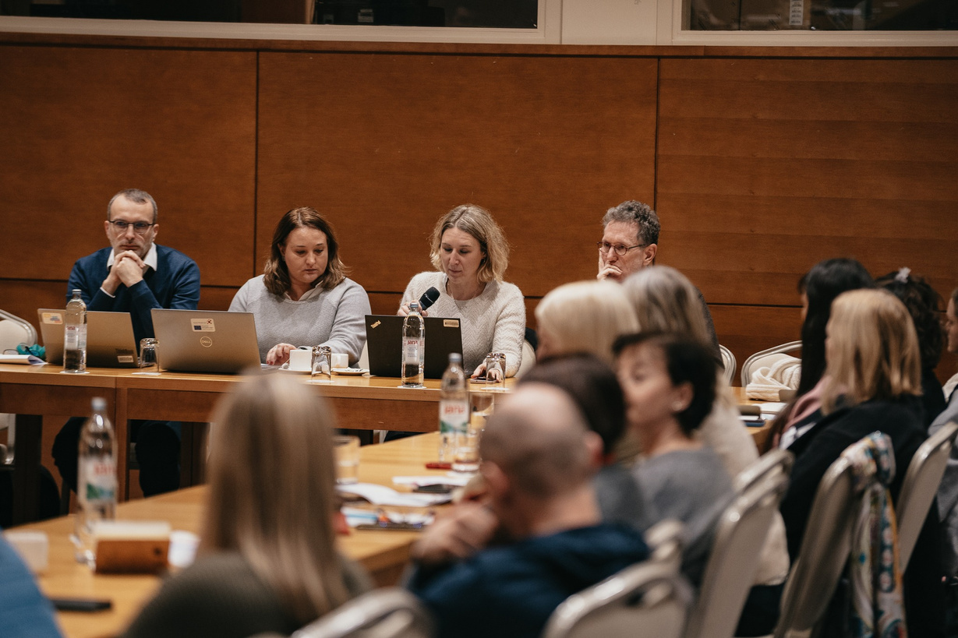
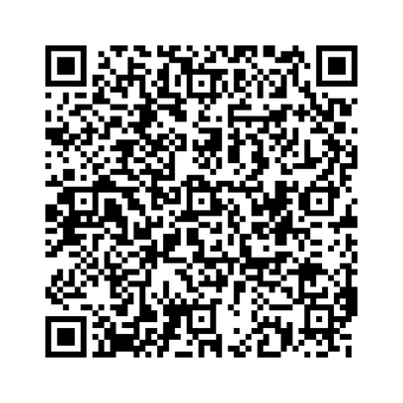
NATIONAL
CONTACT
POINTS
20 March 2025
@DAPHNE Info Session
PRESENTATION:

Slide 116
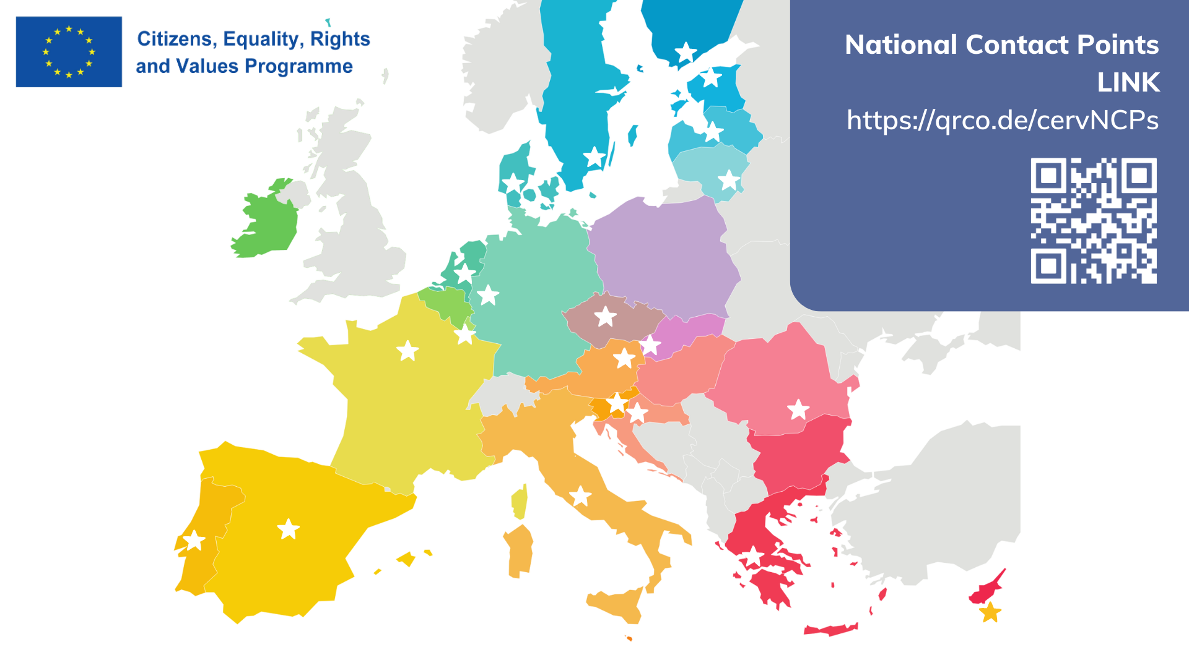


Slide 117

INFORMATION
SUPPORT
    providing information about the Programme & its FUNDING OPPORTUNITIES and about the policy initiatives in the areas covered by the Programme.
    facilitating the MATCH-MAKING between potential partner entities on a transnational level;
    supporting applicants during the APPLICATION PROCESS.
ADVICE
DISSEMINATION
    facilitating the participation of stakeholders and giving advice to applicants;
    increasing the CAPACITY of stakeholders to take part in the Programme.
    dissemination of BEST PRACTICE projects;
    increasing knowledge and awareness of Programme results.
OUR
MISSIONS

Slide 118
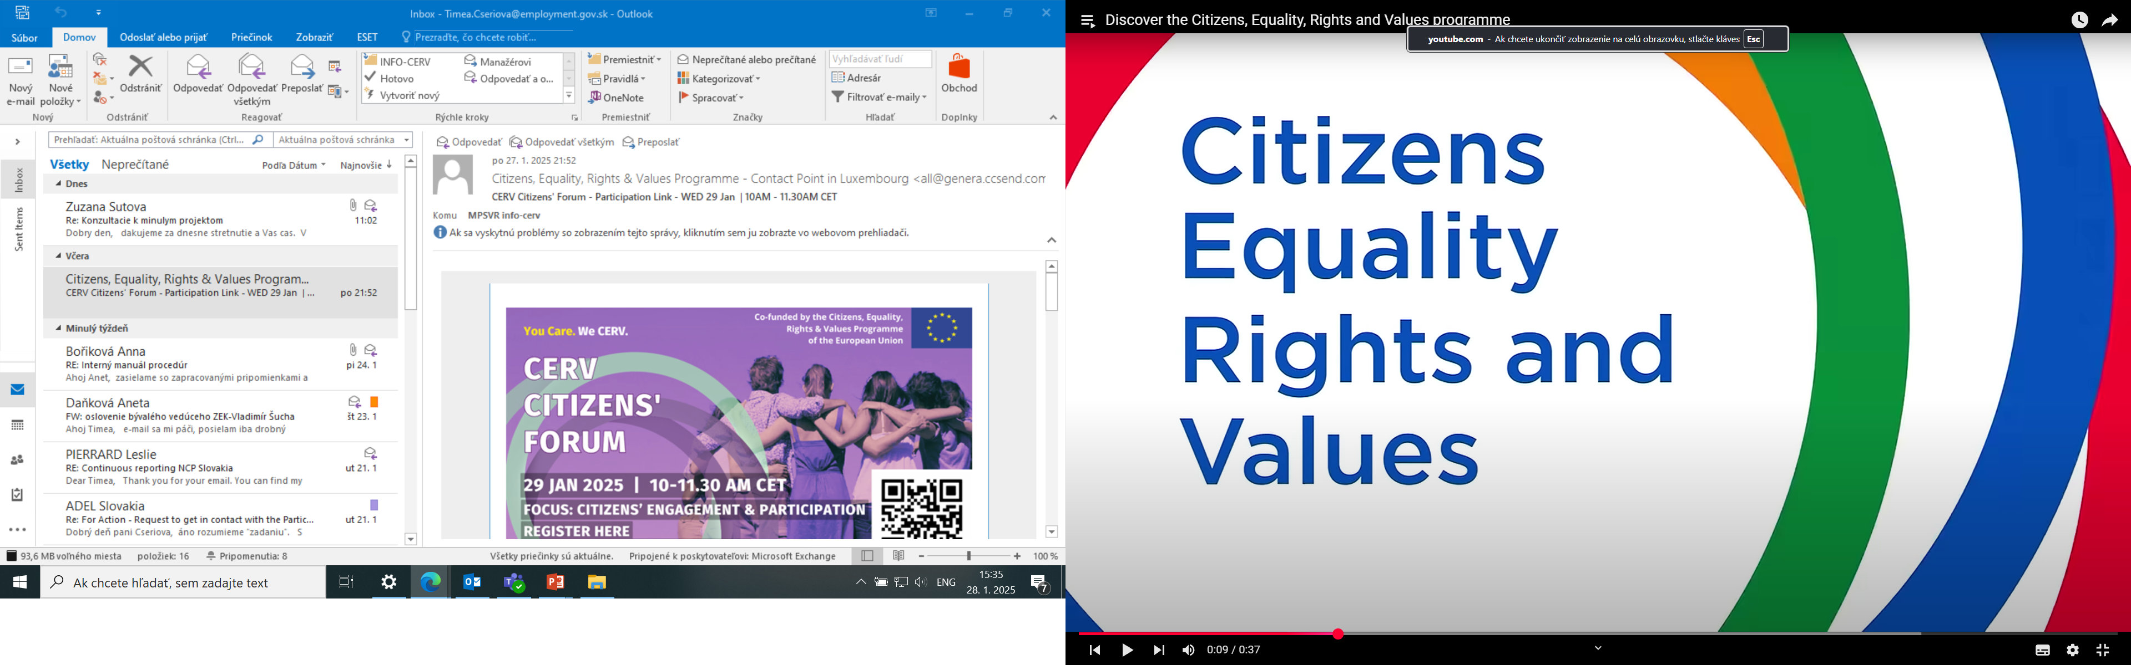


NCP CERV Partner Search
https://qrco.de/
CERVps

Slide 119
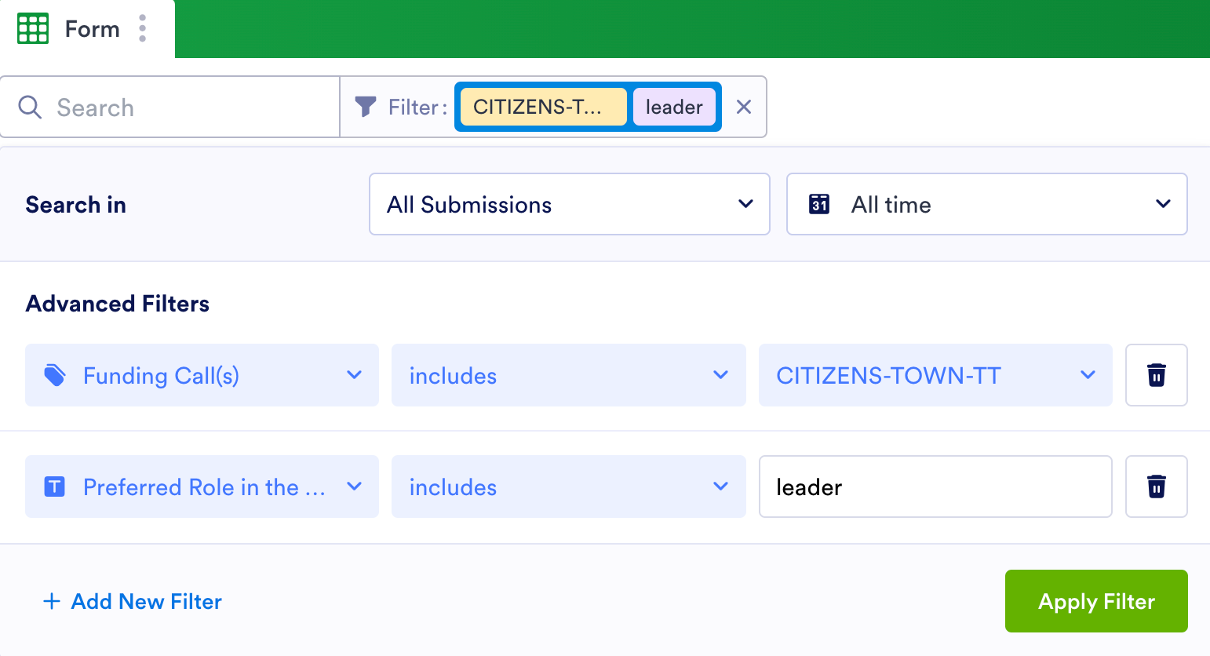
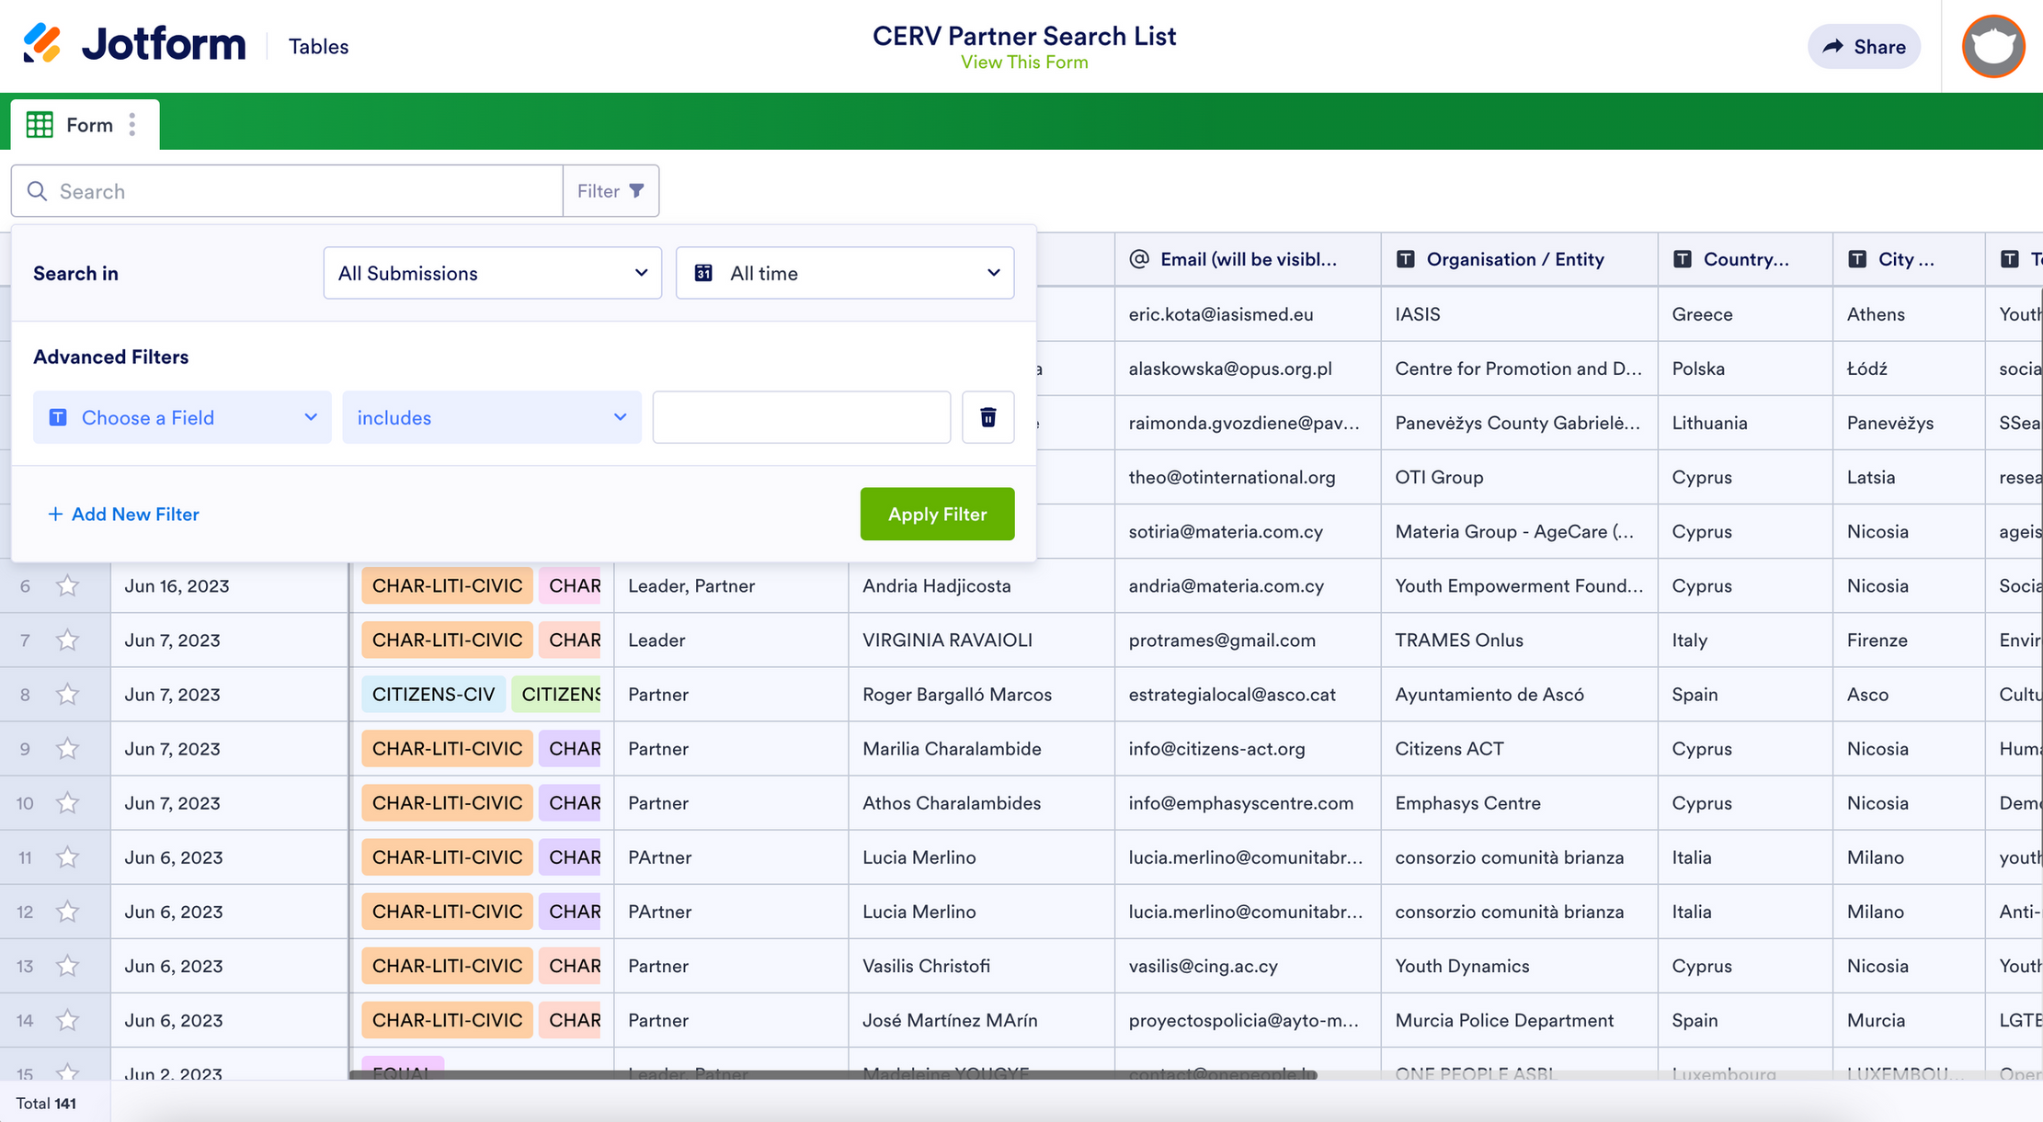

NCP CERV Partner Search
https://qrco.de/
CERVps

Slide 120


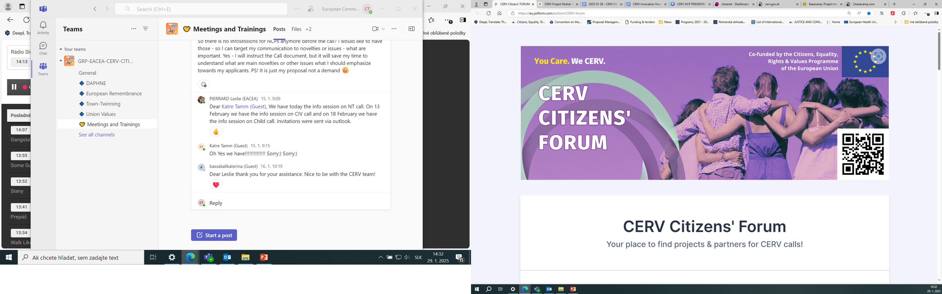


JOINT EVENTS
NCP Events Registration
    Learn more about current CERV calls
    Receive direct support from the CERV national contact points
    Present your project idea or topic and moderate a break-out room (or participate in break-out rooms initiated by other participants)
    Create new p﻿rojects or join projects in the making
    Expand your project team and create synergies
https://qrco.de/
CERV-forum

Slide 121
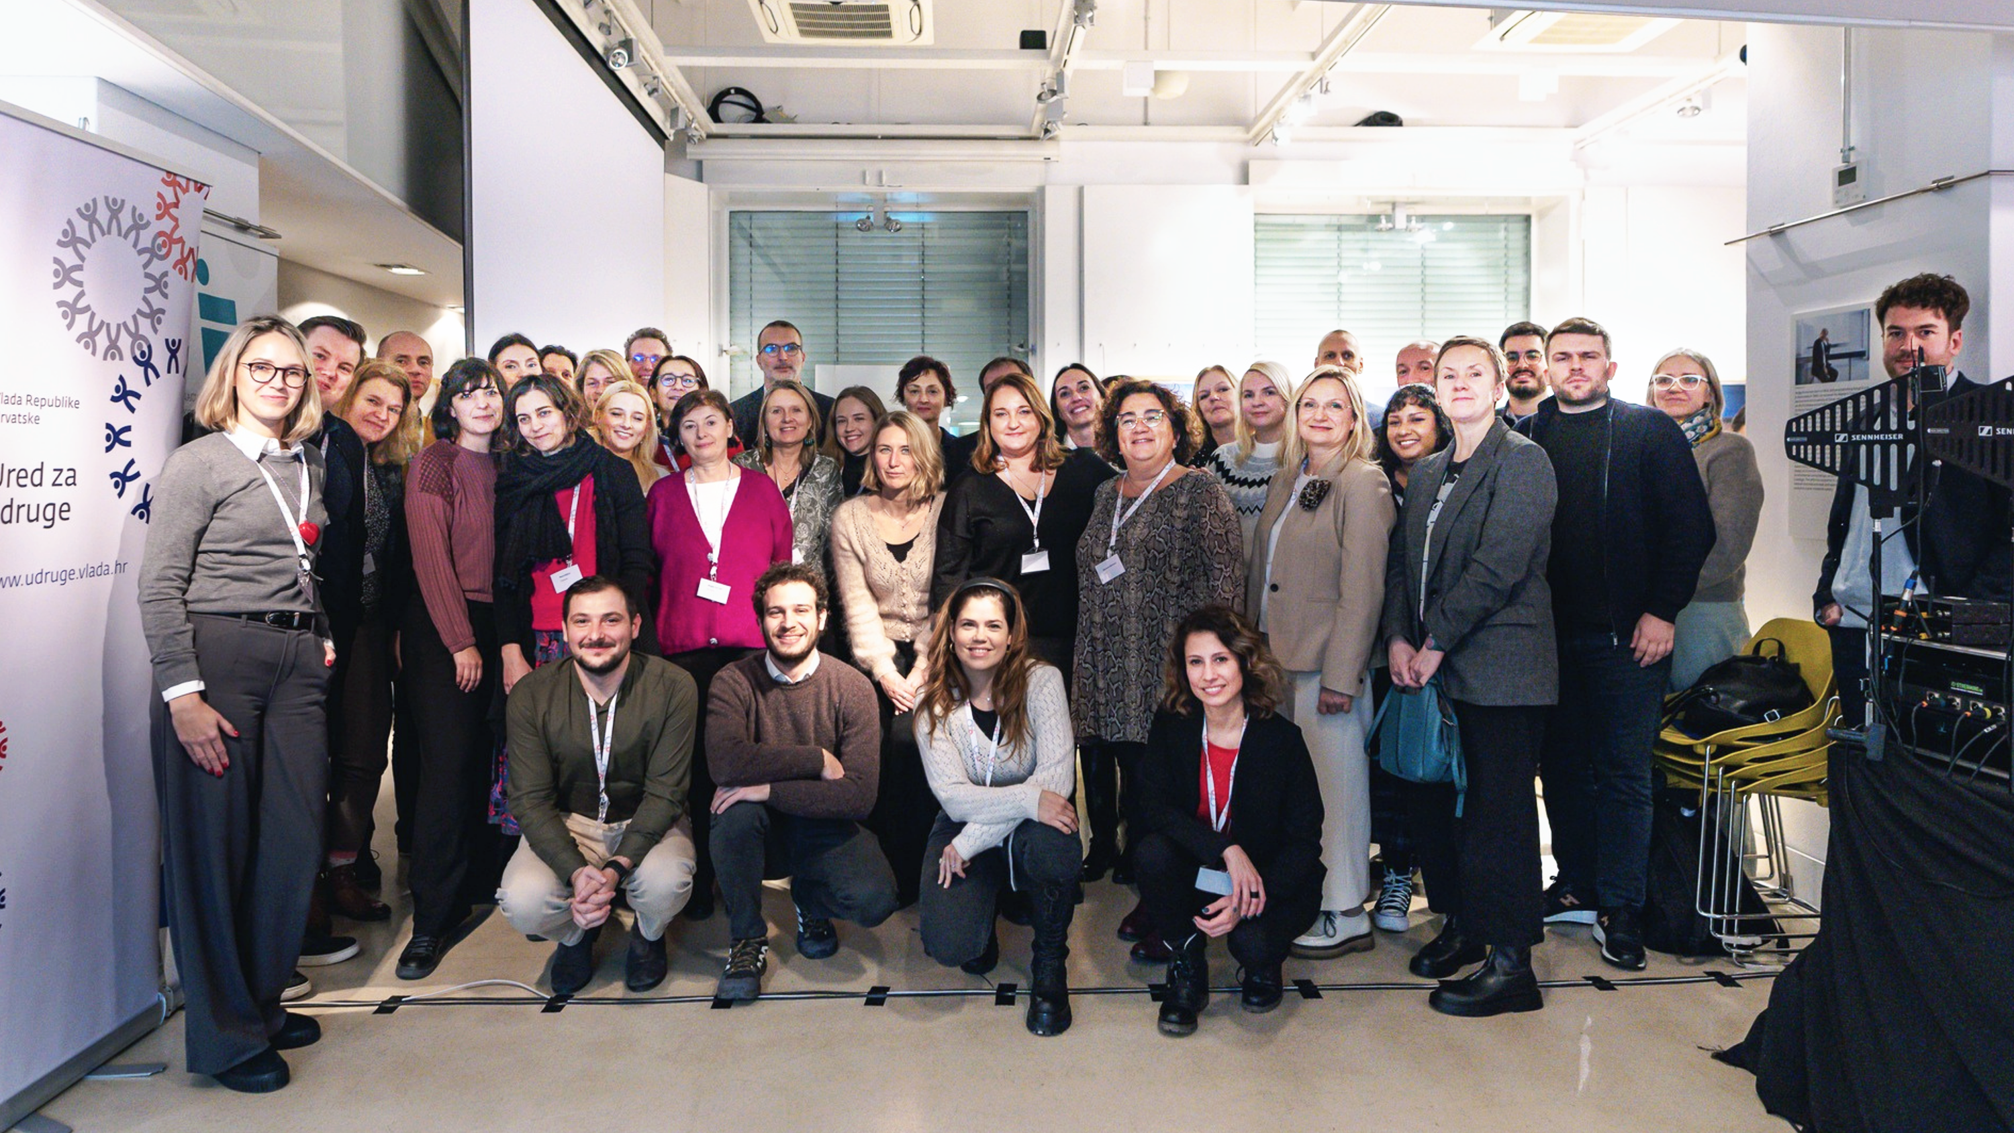

Slide 122
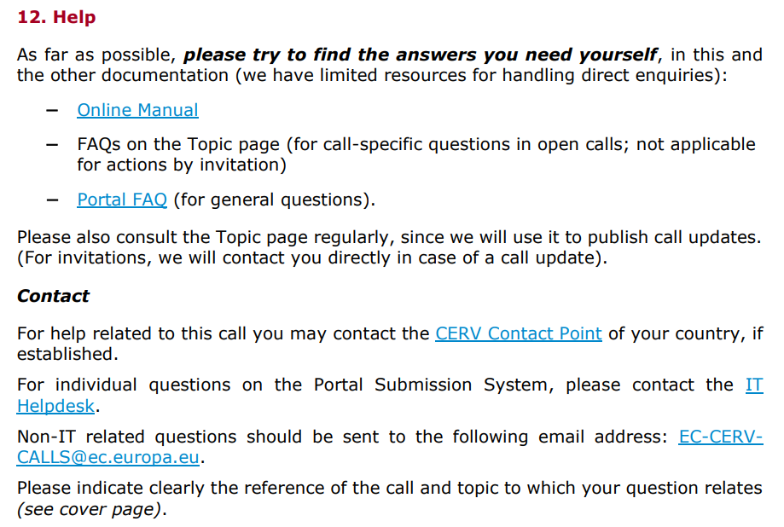
Assistance

Slide 123
Have your say!
EU public consultation and feedback on EU’s next long-term budget
Consultation period: 12 February 2025 -07 May 2025
EU’s next long-term budget (MFF) –EU funding for cross-border education, training and solidarity, young people, media, culture, and creative sectors, values, and civil society
The Commission would like to hear your views!!

Slide 124

Thank you
for your attention & have a great day!

