Slide 1

The Citizens, Equality, Rights and Values programme 2021-2027

Slide 2
What are the objectives ?
To protect and promote rights and values as enshrined in the Treaties, the Charter and in the applicable international human rights conventions, in particular by supporting civil society organisations and other stakeholders active at local, regional, national and transnational level, and by encouraging civic and democratic participation, in order to sustain and further develop open, rights-based, democratic, equal and inclusive societies based on the rule of law
Union values strand
Equality, Rights and Gender Equality strand
Daphne strand
Citizens' engagement and participation strand

Slide 3
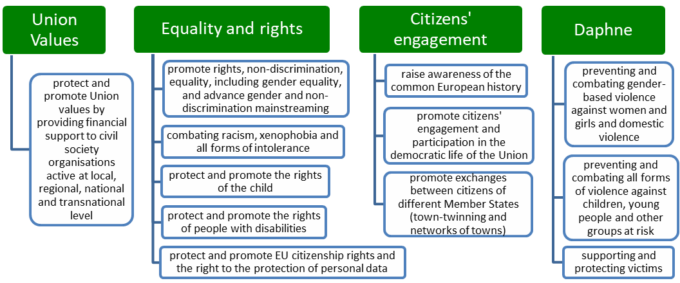
CERV Programme – Four strands

Slide 4
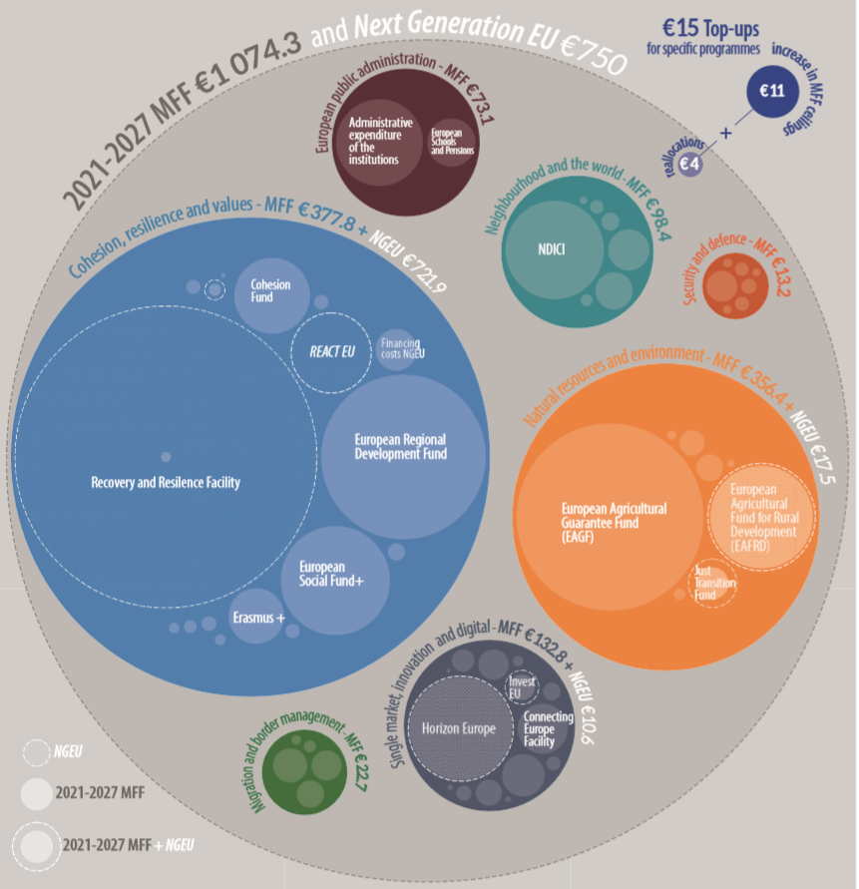
Overall MFF package
The CERV programme
has a total budget of
around € 1.55 billion
for the period 2021-2027

Slide 5
Earmarking of the budget
44,38% for Union Values 24,45% for Equality, Rights, GE and Daphne of which at least 40 % for gender-based violence at least 15 % to gender equality 25,31% for Citizens engagement and participation of which at least 65% for democratic participation at least 15 % for remembrance activities. 5,87% flexibility margin
at least 50 % of strand Union values, strand Equality, Rights, GE and strand Daphne should be allocated to support activities carried out by
civil society organisations, of which at least 40 % shall be allocated to
local and regional
civil society organisations

Slide 6
Upcoming CERV calls for proposals
CERV Calls for proposals | Call reference | Budget | Opening | Deadline
Call for proposals on protecting and promoting Union values | CERV-2021-CITIZENS VALUES | 50,5M | Q4 2021 | 01/02/2022
Call for proposals to promote capacity building and awareness on the EU Charter of Fundamental Rights and activities on strategic litigation relating to democracy, rule of law and fundamental rights breaches | CERV-2022-CHAR-LITI | 2M | Q4 2021 | 15/01/2022
Call for proposals to promote equality and to fight against racism, xenophobia and discrimination | CERV-2022-EQUAL | 12,2M | Q2 2022 | 24/02/2022
Call for proposals limited/restricted to National Roma Contact Points | CERV-2022-NRCP | 1,9M | Q4 2021 | 3/03/2022
Call for proposals to promote gender equality | CERV-2022-GE | 6,8M | Q4 2021 | 16/03/2022
Call for proposals to protect and promote the rights of the child | CERV-2022-CHILD | 3M | Q4 2021 | 18/05/2022
Call for proposals to national Data Protection Authorities | CERV-2021-DATA |  | Closed
Call for proposals on European remembrance | CERV-CITIZENS-2022-REM | 7M | Q4 2021 | 24/03/2022
Call for proposals on Citizens' engagement and participation | CERV-CITIZENS-2022-CIV | 17,4M | Q4 2021 | 10/02/2022
Call for proposals for Town-Twinning and Networks of Towns | CERV-CITIZENS-2022-TOWN | 11M | Q4 2021 | 24/03/2022
Call for proposals to prevent and combat gender-based violence and violence against children | CERV-2022-DAPHNE | 27M | Q4 2021 | 15/04/2022
Call for proposals for 4-year framework partnership agreements to support European networks, civil society organisations active at EU level and European think tanks in the areas of Union values | CERV-2021-OG-FPA |  | Closed
Operating grants to Framework Partners active in the areas of Union values | CERV-2022-OG-SGA |  | Q3 2022 | 8/09/2022

Slide 7



Citizens’ engagement and participation Strand

Slide 8
Upcoming calls on Citizens' engagement
Town Twinning
Opening : November 2021
Budget : EUR 4M
Maximum grant : EUR 30 000
Network of Towns
Opening : November 2021
Budget : EUR 6M
Maximum grant : no limit
Citizens' engagement
and participation
Opening : October 2021
Budget : EUR 17M
Maximum grant : no limit
European Remembrance
Opening : November 2021
Budget : EUR 7 M
Maximum grant : no limit

Slide 9
Call on Town Twinning
Objectives
Policy priorities:
-
Promoting exchanges between citizens of different countries to give them practical experience of the wealth and diversity of the common heritage of the Union
Europe's cultural and linguistic environment
Mutual understanding and tolerance
European identity and the respect of common values, democracy and
fundamental rights
The European integration process
based on solidarity and common values
The impact of the COVID-19 pandemic on the local communities
App
Applicant / Partner
--
Towns/municipalities, other levels of local authorities, twinning committees or other non-profit organisations representing local authorities
Project duration: max 12 months

Slide 10
Call on Network of Towns
Policy priorities:
Objectives
European dimension and democratic legitimacy of the EU decision-making process
Free, open and healthy democratic governance
Elections, populism, disinformation and challenges facing civil society
Citizens’ active involvement in European political life and the exercise of their electoral rights
The impact of the COVID-19 pandemic on the local communities
-
Promoting exchanges between citizens of different countries to give them practical experience of the wealth and diversity of the common heritage of the Union
App
Applicant / Partner
-
Towns/municipalities, other levels of local authorities, twinning committees or other non-profit organisations representing local authorities
Project duration: max 24 months

Slide 11
Call on Citizens' engagement and participation
Policy priorities:
Objectives
The 2024 European Parliament elections
How the COVID-19 crisis has affected the democratic debate and the enjoyment of fundamental rights
Innovative democratic approaches and tools (e-Democracy)
Countering disinformation and promoting media literacy
Engage citizens in discussions linked to our climate and environment
Supporting projects promoted by transnational partnerships and networks directly involving citizens, giving them an opportunity to actively participate in the EU policymaking process
App
App
Applicant / Partner
Partner
Civil society organisations, educational, cultural or
research institutions
Public local/
regional authorities
Project duration: max 24 months

Slide 12
Union Values Strand

Slide 13
Calls on Union Values
Protecting and Promoting
Union Values
Opening : December 2021
Budget : EUR 50M
Promote capacity building and awareness on the EU Charter of Fundamental Rights and activities on strategic litigation relating to democracy, the rule of law and fundamental rights breaches
Opening : October 2021
Budget : EUR 2M
Operating Grant FPA
Submission deadline closed
Operating Grant SPA
Submission deadline closed

Slide 14
Call on protecting and promoting Union values
EACEA
Intermediary
Intermediary
Intermediary
CSO
CSO
CSO
CSO
CSO
Intermediary
CSO
CSO
CSO
CSO
CSO
CSO
CSO
CSO
CSO
CSO
CSO
Intermediary
CSO
CSO
CSO
CSO
Launch three calls for proposals during the period 2021-2027
3 years action grants
Build knowledge and capacity and regrant
Protect, promote and raise awareness on rights and values

Slide 15
The role of intermediaries
support to the preparation and implementation of activities of CSOs,
train and build the capacity and sustainability of CSOs,
policy development and engagement of CSOs,
promote and facilitate networking.
Build knowledge and capacity
and regrant

Slide 16
Funded actions for civil society organisations
Awareness raising communication
civic platforms and civil dialogues
Protect, promote and raise awareness on rights and values
Coalitions and partnerships among CSOs
Watchdog and monitoring activities
Lobbying
advocacy
Research and analysis

Slide 17
Contacts and useful links
How to apply: Go to the Funding & Tenders Opportunities Portal
Watch info sessions on how to apply
Seek for technical assistance
See the CERV Programme structure, the Work Programme and Regulation
Read carefully the text of the call for proposal
Seek for guidance with the CERV Contact Points (in 15 EU Countries)
Watch this presentation during the EWRC event
Watch previous presentations during the CERV Dialogue Week
Subscribe to DG Justice Newsletter

Slide 18
Contacts and useful links
Funding & Tenders Opportunities Portal : https://webgate.ec.europa.eu/funding-tenders-opportunities/display/OM/Online+Manual
Info sessions on how to apply : https://www.eacea.ec.europa.eu/grants/how-get-grant_en
Technical assistance : https://ec.europa.eu/info/funding-tenders/opportunities/portal/screen/support/helpdesks/contact-form
CERV calls for proposals : https://ec.europa.eu/info/funding-tenders/opportunities/portal/screen/programmes/cerv
CERV 2021-2027 Work Programme and CERV Contact Points : https://ec.europa.eu/info/departments/justice-and-consumers/justice-and-consumers-funding-tenders/funding-programmes_en
Regulation establishing the CERV Programme : https://eur-lex.europa.eu/eli/reg/2021/692/oj
Wath this presentation during the EWRC event : https://www.youtube.com/watch?v=eqSiYZ6GOUg
Watch previous presentations during the CERV Dialogue Week : https://cerv-civil-dialogue-week.eu/home
DG Justice Newsletter : https://ec.europa.eu/newsroom/just/user-subscriptions/1148/create

