Slide 1

The 2023 CHAR-LITI Call for proposals under the CERV
We will be starting at 09:00 o'clock
Online information session
Brussels,
26 Jan 2023

Slide 2
Warm welcome to you!
Hosting team:
Larisa Antohi, Alessia Valentino, Femke Gremmelprez, Csilla Dobosi, Johannes Boermann

Slide 3


Overview
CERV programme policy priorities under the Charter of Fundamental Rights of the EU
Capacity building and awareness raising on the EU Charter of Fundamental Rights
Promoting rights and values by empowering the civic space
Strategic litigation
Q&As
Application process for the 2023 calls for proposals
timeline, eligibility, actions, impacts, portal CERV, examples, Q&As
Ask your question!

Slide 4
Policy priorities of the CERV Charter Call

Slide 5
The EU Charter call in DG Justice policies
The EU Charter of Fundamental Rights call
European Democracy Action plan
Whistleblower protection Directive
Protection from SLAPP
Rule of law report
Strategy to strengthen the application of the EU Charter
Hate speech and hate crime initiative
Annual Charter Reports

Slide 6
Policy Priorities for the 2023 Charter call
Capacity building and awareness on
the EU Charter of Fundamental Rights
Promoting rights and values by empowering the civic space
Strategic litigation
Supporting an enabling environment for the protection of whistleblowers

Slide 7
Capacity building and awareness raising on the EU Charter of Fundamental Rights
Topic ID: CERV-2023-CHAR-LITI-CHARTER

Slide 8
Suporting the Commission policy work
The 2020 Strategy to strengthen the application of the Charter of Fundamental Rights in the EU
The Annual reports on the application of the EU Charter of Fundamental Rights
The 2021 Annual Charter report focused on fundamental rights in the digital age
It underlines the importance of strengthening the application of the Charter in the Member States through
awareness raising and capacity building initiatives.
It monitors progress in the areas where the EU has powers to act, showing how the Charter has been considered in actual cases, notably when new EU legislation is proposed.
Since 2021, the Annual Charter report focuses on different themes of strategic relevance governed by EU law.

Slide 9
How would the projects support the Commission work towards the Charter in general?
Rights enshrined in the Charter and awareness of the Charter’s scope of application
    Cf Article 51, the Charter is applicable to Member States only when they are implementing EU law. Given the specific nature of this instrument, in comparison with other international Treaties protecting fundamental rights, and considering the increasing number of references to the Charter in the case law of the Court of Justice of the EU
    there is a specific need to promote a good understanding of the rights enshrined in the Charter and of the situations in which the Charter applies, i.e. when EU law is being implemented.

Slide 10
How would the projects support the Commission work towards the Charter’s themes?
Protecting fundamental rights in the digital age
In practice, the projects will develop
guidelines (measures that ensure gendersensitive implementation), technical benchmarks and tools, including for algorithm-audits
a concrete tool or a benchmark process in an area of the applicant’s choice with demonstrated relevance for fundamental rights, without prescribing the area or the type of the tool (e.g. it could be software, a benchmark data set, a simulation environment, a procedure).
Aims to protect fundamental rights by strengthening accountability for the use of automation where rights are at stake.
This includes approaches for addressing and combatting bias and multiple/intersectional discrimination
based on gender and on other grounds including ethnic and racial origin, caused or intensified using artificial intelligence systems.

Slide 11
Expected results
Capacity building of civil society organisations and awareness raising activities aiming to increase the knowledge and the use of the EU Charter, including its gender dimension, especially on its scope of application;
Facilitating cooperation between civil society organisations and other key partners in enforcing the Charter, such as NHRIs, Equality bodies, Ombuds Institutions and Member State authorities (at national, regional and local level);
Training and train-the-trainer activities for professionals (such as experts, lawyers and legal advisers, communicators, policy and advocacy advisers), including through operational guidance and learning tools;
Mutual learning, exchange of good practices, development of working and learning methods, including mentoring programmes that may be transferable to other countries;
Analytical activities, such as sex-disaggregated data collection and research, and the creation of tools or data bases (e.g. thematic databases of jurisprudence);
Communication activities, including dissemination of information and awareness raising about rights and redress mechanisms, relevant to the priorities of the call;
Development of procedures, guidelines, technical benchmarks, and tools, including for algorithm-audits, to help to protect fundamental rights, including gender equality and non-discrimination, where automation is used.

Slide 12
Expected Impacts
Increased awareness and better use of the Charter by CSOs, NHRIs, equality bodies, Ombuds Institutions, other rights defenders, and Member State authorities;
Improved knowledge of available redress mechanisms under national and EU law, and how to make the best use of them for the benefit of rights holders;
Improved cooperation between CSOs, NHRIs, Equality bodies, Ombuds Institutions, other rights defenders and Member State authorities on Charter-related issues;
Increased prevention, mitigation, detection of and redress for breaches of fundamental rights, including algorithmic discrimination;
Improved accountability of the development and use of automated systems, including specific algorithms and their output;
Increased capacities to mitigate or otherwise address discriminatory biases in automated systems;
Improved knowledge of fundamental rights, including gender equality and non-discrimination law, the legal requirements associated with the development and use of automated systems, and of practical approaches to ensure compliance.

Slide 13
Promoting rights and values by empowering the civic space
Topic ID: CERV-2023-CHAR-LITI-CIVIC

Slide 14
Commission policy: enabling civic space
2020 Strategy to strengthen the application of the Charter of Fundamental Rights in the EU “Civil society organisations and rights defenders should be able to work without fear in a supportive environment.”
2022 Annual Charter report, A thriving civic space for upholding fundamental rights in the EU “Civil society organisations (CSOs) and rights defenders are essential in our constitutional democratic societies to bring life to and protect the values and rights enshrined in Article 2 of the Treaty on European Union and in the Charter [...] [they] should be able to work in an environment where their own fundamental rights are respected”
Annual Rule of law reports, Pillar IV: check and balances – the framework for civil society
Fundamental Rights Agency (FRA) work on civic space

Slide 15
Commission policy: enabling civic space
C-78/18: the European Court of Justice made clear that:
  civil society organisations “must be able to pursue [their] activities and operate without unjustified interference by the State”.
  the right to freedom of association constitutes one of the essential foundations of a democratic and pluralist society, as it enables citizens to act collectively in areas of common interest and, in so doing, contribute to the proper functioning of public life.

Slide 16
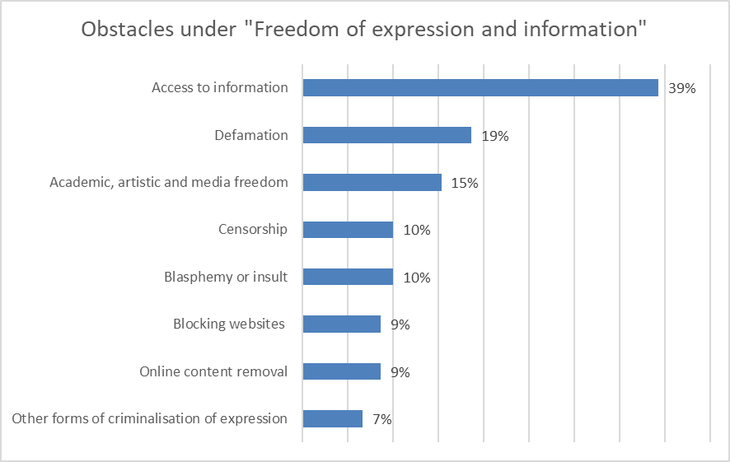
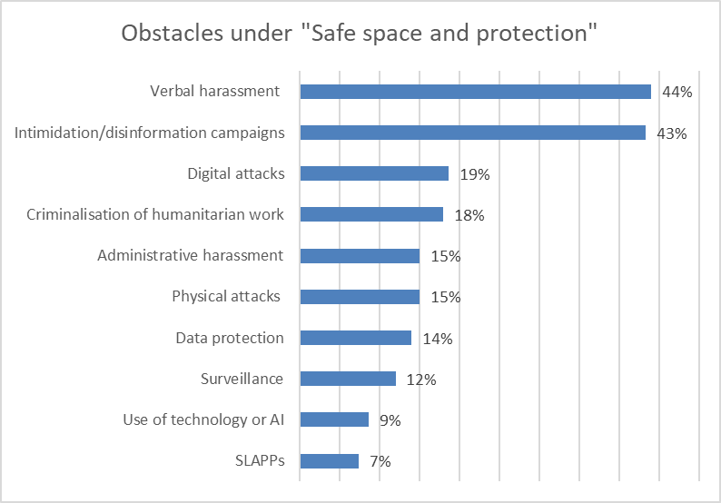
Commission policy: enabling civic space
CSOs and rights defenders still report a range of challenges, obstacles and restrictions in certain Member States that have limited their ability to carry out their activities

Slide 17
How would the projects support the Commission work towards an enabling civic space?
MONITORING: creation of a systematic and comprehensive monitoring system to regularly and consistently monitor the environment in which civil society organisations work in the national contexts,
  building on the Fundamental Rights Agency indicators about the shrinking civic space and of internal organisations’ data ,
  and in particular of breaches of CSOs and rights defenders’ fundamental rights.
PROVIDING SUPPORT SERVICES: to CSOs and their members under attacks: legal, practical (medical, psychological, family, etc.)

Slide 18
Which are the expected results?
Increased awareness about the state of play on civic space in the EU;
Strengthened relations and creation of networks among the actors protecting the civic space;
Increased dialogue on the situation of the civic space, with an increment of public attention to it, and developed positive narratives towards CSOs and rights defenders;
More protected CSOs, CSOs members and rights defenders working in a safe environment;
Increased reporting of attacks faced by the targeted actors and more prompt and targeted response.

Slide 19
Strategic litigation
Topic ID: CERV-2023-CHAR-LITI-LITIGATION

Slide 20
Commission policy: advancing the judicial protection of fundamental rights
What is needed for an effective litigation strategy?
  In depth knowledge of the legal instruments + ability of develop creative legal argument;
  communication skills;
  advocacy;
  and community engagement.
Why is strategic litigation key to advance the protection of fundamental rights?
  Legally binding decisions;
  Cross borders impact;
  Community impact.

Slide 21
Commission policy: advancing the judicial protection of fundamental rights
What is new this year?
  Projects under this priority can also include a focus on countering manifestly unfounded or abusive court proceedings against journalists and human rights defenders who engage in public participation (Strategic lawsuits against public participation - SLAPP).
    What is SLAPP?
SLAPPs are manifestly unfounded or abusive court proceedings. They are a particular form of harassment increasingly used against journalists, human rights defenders and others engaged in public participation in a matter of public interest and upholding democratic values and fundamental rights.

Slide 22
Commission policy: advancing the judicial protection of fundamental rights
What is not new?
  The litigation fees will not be funded.

Slide 23
How would the projects support the Commission work towards an enabling civic space?
There could be a focus on specific Charter rights? YES.
Which type of activities are covered?
  Training, knowledge sharing, and exchange of good practices;
  data collection and research, and the creation of tools or data bases (e.g. thematic databases of jurisprudence);
  Communication activities, including dissemination of information and awareness raising about rights, redress mechanisms, and strategic cases;
  Capacity building and awareness raising activities to counter manifestly unfounded or abusive court proceedings against journalists and human rights defenders who engage in public participation (Strategic lawsuits against public participation).

Slide 24
Which are the expected results?
Increased awareness and knowledge about EU law, the Charter, the existing remedies and redress mechanisms to enforce them at national and European level, including the preliminary ruling mechanism;
Strengthened abilities of legal professionals and practitioners to cooperate and engage in litigation practices;
Increased awareness on the use and of the safeguards and strategic protection against SLAPP.

Slide 25
Any question?

Slide 26
Citizens, Equality, Rights and Values (CERV) programme
2021-2022 Lessons learned

Slide 27

Budget, objective and structure
To protect and promote rights and values as enshrined in the EU Treaties and the EU Charter
Supporting civil society organisations (CSOs) and other stakeholders active at local, regional, national and transnational level,
Encouraging civic and democratic participation to sustain and further develop open, rights-based, democratic, equal and inclusive societies based on the rule of law
CERV Budget
2021-2027
Union values strand
Equality, Rights and Gender Equality strand
Daphne strand
Citizens' engagement and participation strand
EUR 1.550 million

Slide 28
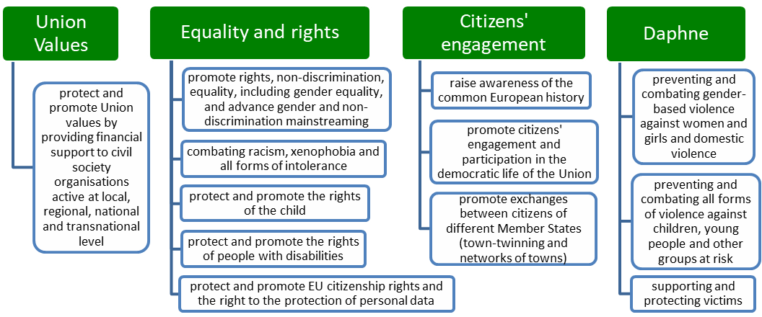
The CERV strands

Slide 29
New in CERV
Union Values
(Re-granting)
New call with EUR 51 million in 2022
National Contact Points
27 national relays
Multi-year work programme
2021-2 Work Programme with
Re-granting scheme to support small and grassroots NGOs
Providing:
Merging of two programmes
Rights, Equality and Citizenship 2014-2020
Europe for Citizens 2014-2020
Advanced planning for all calls
Bigger transparency and earlier information for stakeholders
→ multi-year priorities
EUR 2,5-4,5 million per organisation
19 appointed so far
guidance and practical information
assistance to applicants, stakeholders and beneficiaries
→ Soon for framework partners (EUR 5,6 million in 2022)
EUR 292 million
citizen engagement and participation, town-twinning, European remembrance
combating racism, gender-based violence,…etc

Slide 30






Framework partners and CSO networks

Slide 31

Key facts on CERV impact in 2021-2022
Almost 1500 CSOs supported
3616 ENTITIES reached
22 call for proposals
EUR 131 million disbursed to CSOs
EUR 51 million to local and grassroots CSOs

Slide 32
The 2023 Charter call

Slide 33
Key facts
2023 Call for proposals on the Charter of Fundamental Rights
2nd Charter call with 8 times more budget
24 January 2023 – 25 May 2023 (16 weeks submission time)
EUR 16 million with min single grant of EUR 75.000
Single applicant or consortium
National or transnational projects
Only organisations established in the EU
Project duration max 2 years

Slide 34
Activities under the 2023 Charter call
Awarness of the EU Charter
to increase the knowledge and the use of the EU Charter
Empowering the civic space
monitor the civic space in EU Member States
Capacity building in CSOs on monitoring the civic space;
Strategic litigation
increase the ability of CSOs in the area of strategic litigation on fundamental rights under the Charter
Protection of whistleblowers
Cooperation between CSO and other key actors in enforcing the Charter
Training and train-the-trainer activities for professionals
Development of procedures, guidelines, technical benchmarks and tools, including for algorithm-audits
support and the protection of CSOs, their members and other rights defenders
Development of synergies between local, regional, national and European level
Capacity building and awareness raising activities to counter abusive court proceedings against journalists and human rights (Strategic lawsuits against public participation).
! the litigation fees will not be funded.!
Develop guidance or training materials for the implementation of the Directive on whistleblower protection
increase the public’s knowledge and understanding of the national laws transposing the Directive, of the existence of the internal and external reporting channels.

Slide 35

The eligible participants for the 2023 Charter call
Coordinator
Be non-profit legal entities (private bodies).
Co-applicant
Be non-profit or profit legal entities (public or private bodies).
Other applicants
International organisations
National human rights institutions,
Equality bodies
Ombuds Institutions
The 2023 Charter call for proposals

Slide 36
Horizontal aspects of the 2023 Charter call
Child protection
Activities involving children must have a child protection policy covering the four areas described in the Keeping Children Safe Child Safeguarding Standards.
EU values
Applicants must show in their application that they respect ethical principles
Gender main-streaming
Projects’ design and implementation are expected to promote gender equality and non-discrimination mainstreaming.
Gender analysis, mapping potential different needs of and impact on women and Amen
Applicants are expected to design and implement their communication and dissemination activities in a gender-sensitive way.
Proposals that integrate a gender-perspective across all their activities will be considered of higher quality.
Integrating a gender equality perspective in the design of the activities.
Respect EU values based on Article 2 of the Treaty on the European Union and Article of the 21 EU Charter of Fundamental Rights
Check of all applicants of a consortium for EU Values compliance
This policy must be available online and transparent. It must include clear information about the recruitment of staff (including trainees and volunteers) and include background checks (vetting).
It must also include clear procedures and rules to staff, including reporting rules, and continuous training.
The 2023 Charter call for proposals

Slide 37
The 2022 Call for proposals on capacity building and awareness on the EU Charter of Fundamental Rights and strategic litigation

Slide 38
The EU Charter and strategic litigation
Project examples

Slide 39

Example 1
CharterWise. Making the EU Charter a leading human rights litigation tool in Hungary
  Project partners. Hungarian Helsinki Committee and Hungarian Civil Liberties Union
empower 25 CSO reps as Charter champions
train 45 HU attorneys
academic Charter curriculum for 60+ HU law students
awareness-raising campaign for 5000 people
via blended learning and a strategy-building retreat
EUR 186,469
EU contrib
incl model training curriculum for attorneys with Bar Assoc
with HU law schools
Objectives
incl legal professions, active citizens, potential victims

Slide 40

Example 2
FULFIL. Protecting and promoting fundamental rights of migrant women in the EU
  Project in BE – FR – IT – PT and BE-lead, Reseau europeenne des femmes migrantes
strengthen legal professionals in the EU
engage specialised CSOs working with law enforcement & justice professionals
use nationally the Charter in legal support, intervention & litigation
strategic litigation and case-law training
incl equality bodies, diplomatic missions and law enforcement (FR IT PT)
EUR 351,025 EU contrib
incl vulnerable migrant women (here), lawyers and judiciary
in breaching cases of fundamental rights of migrant women, incl third country nationals and EU mobile citizens
Objectives
incl a toolkit for professionals, cross-border mutual learning, info exchange & good practices, creation of a case law database and a legal expert network

Slide 41
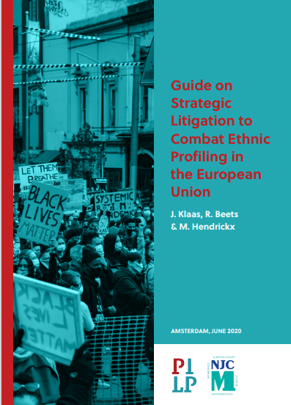


Example 3
CEPEUSEL. Combatting Ethnic Profiling in the EU through Strategic Litigation by the Netherlands Jurists Committee for Human Rights
  Project in the NL. Nederlands Juristen Comite voor Demensenrechten

Slide 42
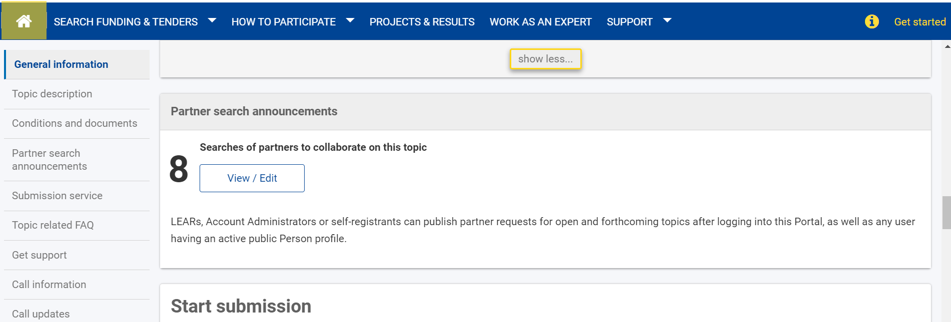
Partner search on Funding & Tender Portal

Slide 43
How to apply
Go to the Funding & tenders opportunities portal
Search Funding & Tenders (europa.eu)
Read carefully the text of the call document
call-fiche_cerv-2023-char-liti_en.pdf (europa.eu)
Questions at EACEA-CERV@ec.europa.eu
For IT-related questions contact form here
Subscribe to DG Justice newsletter on funding opportunies here!

Slide 44
Application process for the 2023 call for proposals
The European Education and Culture Executive Agency

Slide 45
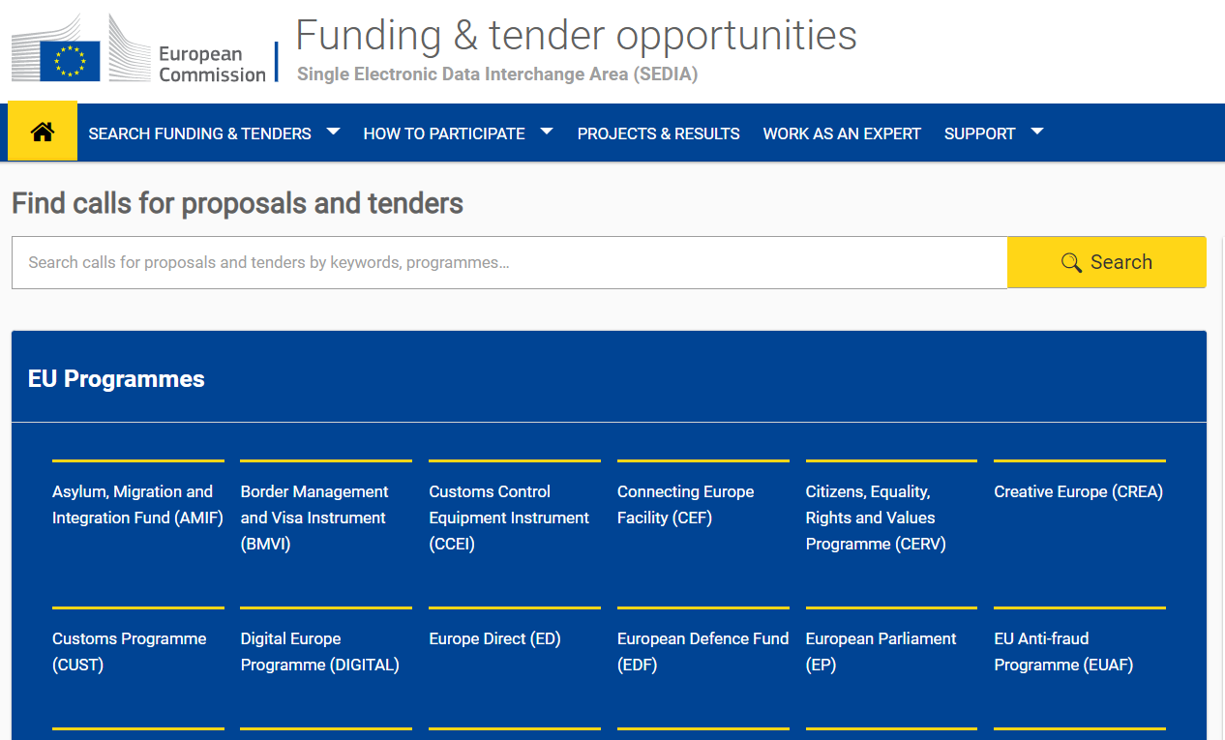
Where to find the Call and submit proposals?
Go to the Funding & tenders opportunities portal

Slide 46
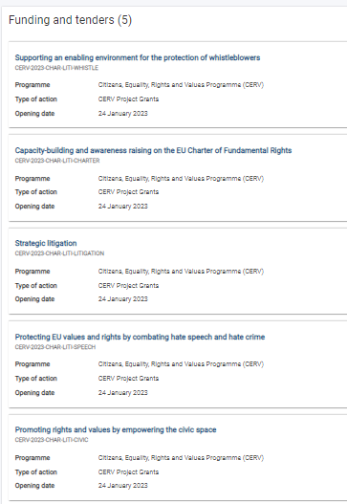
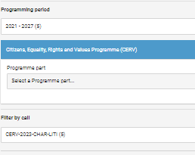

Slide 47
Timetable and deadlines
Call opening | 24 January 2022
Deadline for submission | 25 May 2023 - 17:00:00 CET (Brussels)
Evaluation (by external experts) | June - September 2023
Information on evaluation results | October - November 2023
Grant Agreement signature | January - February 2024

Slide 48
Key aspects
Project duration: between 12 and 24 months
Project budget: min EUR 75 000 – no limit
  Co-financing: the maximum funding rate is 90%
  Budget-based mixed actual cost grant (actual costs, with unit cost and flat-rate elements)
  Budget categories and cost eligibility rules - see Call document p.24-25
1 priority/topic per proposal
      Capacity building and awareness raising on the EU Charter of Fundamental Rights
      Promoting rights and values by empowering the civic space
      Strategic litigation
      Protecting EU values and rights by combating hate crime and hate speech
      Supporting an enabling environment for the protection of whistleblowers

Slide 49
Eligibility criteria
Lead applicants (e.g. the “Coordinator”): non-profit legal entities (private bodies)
Co-applicants: non-profit or profit legal entities (public or private bodies)
! Profit-oriented > ONLY in partnership with private non-profit organisations
Single applicant or consortium
National or transnational
Eligible countries
    EU Member States
    international organisations
Min requested amount > EUR 75.000

Slide 50
Admissibility criteria
Respect deadline for submission of application
Electronically: Grant Application Form using the forms provided inside the Funding and Tenders portal
Complete: Part A, part B, part C, annexes, supporting documents

Slide 51
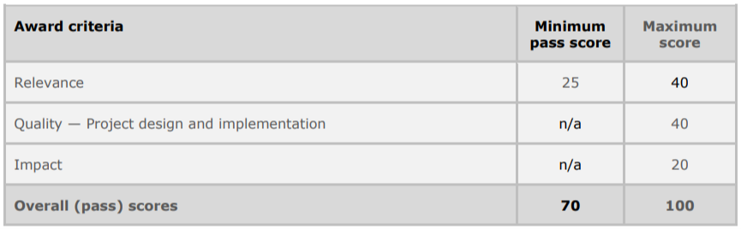
Scoring (100 points) in the Award criteria

Slide 52
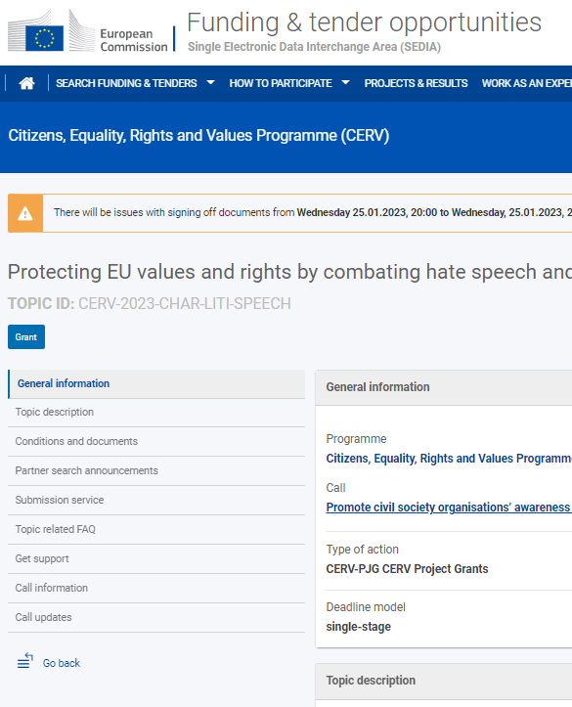
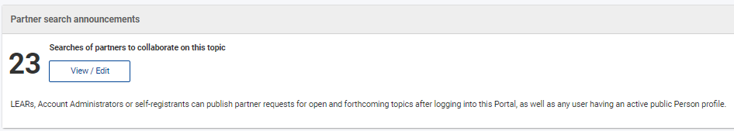
Looking for partners?

Slide 53
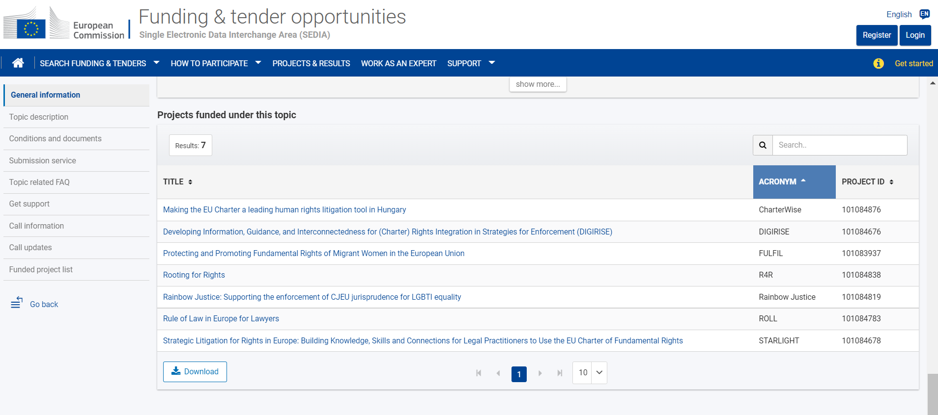
Projects funded under 2022-CHAR-LITI

Slide 54
EACEA CHAR-LITI Call information session
  Date: 16 February 2023, 10:00-12:30
  Registration open: EACEA website / Info session: CERV-2023-CHAR-LITI (europa.eu)
  Focus on:
      General Call conditions
      Application process (technical aspects, structure)
      Evaluation process (award criteria, eligibility conditions, selection procedure)
      Suggestions, tips and good practices

Slide 55

For more info
Online manual from proposal preparation and submission to reporting on on-going projects
‘IT How to’ support guide with step-by-step walkthroughs and videos
Contact: CERV Contact Point of your country
Questions at EACEA-CERV@ec.europa.eu

Slide 56

Ask your question!

Slide 57

Thank you.
© European Union 2020
Unless otherwise noted the reuse of this presentation is authorised under the CC BY 4.0 license. For any use or reproduction of elements that are not owned by the EU, permission may need to be sought directly from the respective right holders.

